Slide 1
Coursenotes
CS3114: Data Structures and
Algorithms
Clifford A. Shaffer
Department of Computer Science
Virginia Tech
Copyright © 2008-2012

Slide 2
Goals of this Course
Reinforce the concept that costs and benefits exist for every data structure.
Learn the commonly used data structures.
These form a programmer's basic data structure ``toolkit.'‘
Understand how to measure the cost of a data structure or program.
These techniques also allow you to judge the merits of new data structures that you or others might invent.
Notes:
The first goal is a worldview to adopt
The second goal is the “nuts and bolts” of the course.
The third goal prepares a student for the future.

Slide 3
Role in the Curriculum
This course represents a transition between “learning to program” courses (CS 1114, CS 2114) and “content” courses.
To do well, you must be able to handle both
Programming (we focus on projects with dynamic memory allocation and file processing)
Content, theory and analysis
Notes:
To handle the content: Each day before class, spend 5-10 minutes reviewing the material covered in the last class.
To handle the projects: Make and stick to a schedule that spreads the works sensibly over time, so that you are not working on the project at the last minute.

Slide 4
The Need for Data Structures
Data structures organize data
⇒ more efficient programs.
More powerful computers
⇒ more complex applications.
More complex applications demand more calculations.
Complex computing tasks are unlike our everyday experience.
Notes:
A primary concern for this course is efficiency.
You might believe that faster computers make it unnecessary to be concerned with efficiency. However…
So we need special training.

Slide 5
Efficiency
Choice of data structure or algorithm can make the difference between a program running in a few seconds or many days.
A solution is said to be efficient if it solves the problem within its resource constraints.
Space
Time
The cost of a solution is the amount of resources that the solution consumes.
Notes:
Alternate definition: Better than known alternatives (“relatively efficient”).
Space and time are typical constraints for programs.
This does not mean always strive for the most efficient program. If the program operates well within resource constraints, there is no benefit to making it faster or smaller.

Slide 6
Selecting a Data Structure
Select a data structure as follows:
Analyze the problem to determine the basic operations that must be supported.
Quantify the resource constraints for each operation.
Select the data structure that best meets these requirements.
Notes:
Typically want the “simplest” data structure that will meet the requirements.

Slide 7
Costs and Benefits
Each data structure has costs and benefits.
Rarely is one data structure better than another in all situations.
Any data structure requires:
space for each data item it stores,
time to perform each basic operation,
programming effort.
Notes:
The space required includes data and overhead.
Some data structures/algorithms are more complicated than others.

Slide 8
Costs and Benefits (cont)
Each problem has constraints on available space and time.
Only after a careful analysis of problem characteristics can we know the best data structure for the task.
Bank example:
Start account: a few minutes
Transactions: a few seconds
Close account: overnight

Slide 9
Some Questions to Ask
Are all data inserted into the data structure at the beginning, or are insertions interspersed with other operations?
Can data be deleted?
Are all data processed in some well-defined order, or is random access allowed?
Notes:
These questions often help to narrow the possibilities.
If data can be deleted, a more complex representation is typically required.

Slide 10
Abstract Data Types
Abstract Data Type (ADT): a definition for a data type solely in terms of a set of values and a set of operations on that data type.
Each ADT operation is defined by its inputs and outputs.
Encapsulation: Hide implementation details.

Slide 11
Data Structure
A data structure is the physical implementation of an ADT.
Each operation associated with the ADT is implemented by one or more subroutines in the implementation.
Data structure usually refers to an organization for data in main memory.
File structure: an organization for data on peripheral storage, such as a disk drive.

Slide 12
Metaphors
An ADT manages complexity through abstraction: metaphor.
Hierarchies of labels
Ex: transistors ⇒ gates ⇒ CPU.
In a program, implement an ADT, then think only about the ADT, not its implementation.

Slide 13
Logical vs. Physical Form
Data items have both a logical and a physical form.
Logical form: definition of the data item within an ADT.
Ex: Integers in mathematical sense: +, -
Physical form: implementation of the data item within a data structure.
Ex: 16/32 bit integers, overflow.

Slide 14
Data Type
ADT:
Type
Operations
Data Items:
Logical Form
Data Structure:
Storage Space
Subroutines
Data Items:
Physical Form
Notes:
In this class, we frequently move above and below “the line” separating logical and physical forms.

Slide 15
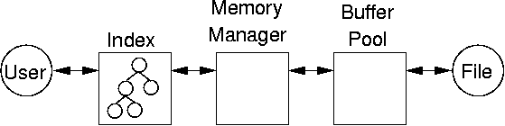
Example 1.8
A typical database-style project will have many interacting parts.

Slide 16
Scheduling
Managing large-scale projects involves scheduling activities
It is human nature to work better toward intermediate milestones.
The same concepts can/should be applied to mid-sized projects encountered in class.
For any project needing more than a week to complete, break into parts and design a schedule with milestones and deliverables.
Find some way to keep track of details.
Notes:
For me, programming takes a lot of focus and concentration. One concern for me is the many details to remember. I use “todo” lists a lot. I find things like the GitHub Issue Tracker invaluable for bigger projects (but that might be overkill for CS3114 class projects). The key thing is to write down any details that occur to you that you don’t want to deal with right this instant.

Slide 17
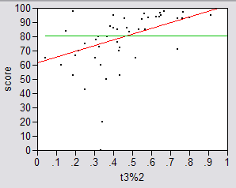
Real Results #1: Fall 2006
Amount Done 1 Week Prior to Due Date

Slide 18
Real Results #2
Results were significant:
90% of scores below median were students who did less than 50% of the project prior to the last week.
Few did poorly who put in > 50% time early
Some did well who didn’t put in >50% time early, but most who did well put in the early time

Slide 19
Real Results #3
Correlations:
Strong correlation between early time and high score
No correlation between time spent and score
No correlation between % early time and total time

Slide 20
What is the Mechanism?
Correlations are not causal
Do they behave that way because they are good, or does behaving that way make them good?
Spreading projects over time allows the “sleep on it” heuristic to operate
Avoiding the “zombie” effect makes people more productive (and cuts time requirements)

Slide 21
Incremental Development
How to fail at implementing your project:
Write the project
Debug the project
How to succeed:
Write the smallest possible kernel
Debug the kernel thoroughly
Repeat until completion:
Add a functional unit
Debug the resulting program
Have a way to track details

Slide 22
Mathematical Background
Set concepts and notation
Logarithms
Recursion
Induction Proofs
Summations
Recurrence Relations
Notes:
Look over Chapter 2, read as needed depending on your familiarity with this material.
A set has no duplicates, a sequence may have duplicates.
Logarithms: We almost always use log to base 2. That is our default base.

Slide 23
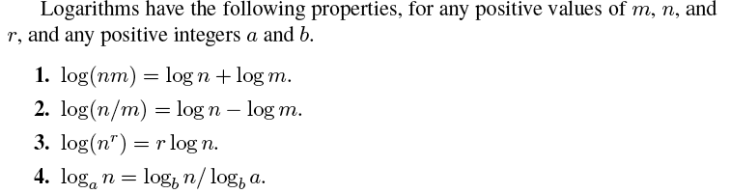
Logarithm
Definition:

Slide 24
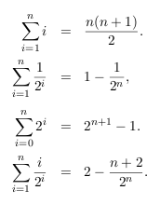
Summation

Slide 25
Recursion
An algorithm is recursive if it calls itself to do part of its work.
Example:
1. Compute n!
2. Hanoi puzzle

Slide 26
Mathematical Proof
Three templates for mathematical proof
Direct Proof
Proof by Contradiction
Proof by mathematical induction

Slide 27
Estimation Techniques
Known as “back of the envelope” or “back of the napkin” calculation
Determine the major parameters that effect the problem.
Derive an equation that relates the parameters to the problem.
Select values for the parameters, and apply the equation to yield and estimated solution.
Notes:
Look over Chapter 2, read as needed depending on your familiarity with this material.
A set has no duplicates, a sequence may have duplicates.
Logarithms: We almost always use log to base 2. That is our default base.

Slide 28
Estimation Example
How many library bookcases does it take to store books totaling one million pages?
Estimate:
Pages/inch
Feet/shelf
Shelves/bookcase
Notes:
Pages/inch: Guess 500
Feet/shelf: Guess 4, actually 3
Shelves/bookcase: Guess 5, actually 7
Units check: pages/in x ft/shelf x shelf/bookcase ⇒ pages/bookcase

Slide 29
Algorithm Efficiency
There are often many approaches (algorithms) to solve a problem. How do we choose between them?
At the heart of computer program design are two (sometimes conflicting) goals.
To design an algorithm that is easy to understand, code, debug.
To design an algorithm that makes efficient use of the computer’s resources.

Slide 30
Algorithm Efficiency (cont)
Goal (1) is the concern of Software Engineering.
Goal (2) is the concern of data structures and algorithm analysis.
When goal (2) is important, how do we measure an algorithm’s cost?

Slide 31
How to Measure Efficiency?
Empirical comparison (run programs)
Asymptotic Algorithm Analysis
Critical resources:
Factors affecting running time:
For most algorithms, running time depends on “size” of the input.
Running time is expressed as T(n) for some function T on input size n.
Notes:
Empirical comparison is difficult to do “fairly” and is time consuming.
Critical resources: Time. Space (disk, RAM). Programmers effort. Ease of use (user’s effort).
Factors affecting running time: Machine load. OS. Compiler. Problem size. Specific input values for given problem size.

Slide 32
Examples of Growth Rate
Example 1.
/** @return Position of largest value in "A“ */
static int largest(int[] A) {
int currlarge = 0; // Position of largest
for (int i=1; i<A.length; i++)
if (A[currlarge] < A[i])
currlarge = i; // Remember pos
return currlarge; // Return largest pos
}
Notes:
As n grows, how does T(n) grow?
Cost: T(n) = c₁n + c₂ steps

Slide 33
Examples (cont)
Example 2: Assignment statement.
Example 3:
sum = 0;
for (i=1; i<=n; i++)
for (j=1; j<=n; j++)
sum++;
}
Notes:
Example 2: Constant cost.
Example 3: Cost: T(n) = c₁n² + c². Roughly n² steps, with sum being n² at the end. Ignore various overhead such as loop counter increments.

Slide 34
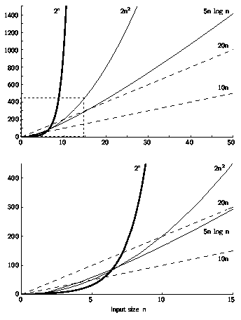
Growth Rate Graph
Notes:
The lower graph corresponds to the box within the dashed lines in the lower left corner of the upper graph.

Slide 35
Best, Worst, Average Cases
Not all inputs of a given size take the same time to run.
Sequential search for K in an array of n integers:
Begin at first element in array and look at each element in turn until K is found
Best case:
Worst case:
Average case:
Notes:
Best: Find at first position. Cost is 1 compare.
Worst: Find at last position. Cost is n compares.
Average: (n+1)/2 compares IF we assume the element with value K is equally likely to be in any position in the array.

Slide 36
Which Analysis to Use?
While average time appears to be the fairest measure, it may be difficult to determine.
When is the worst case time important?
Notes:
Average time analysis requires knowledge of distributions. For example, the assumption of distribution used for average case in the last example.
Worst-case time is important for real-time algorithms.

Slide 37
Faster Computer or Algorithm?
Suppose we buy a computer 10 times faster.
n: size of input that can be processed in one second on old computer (in 1000 computational units)
n’: size of input that can be processed in one second on new computer (in 10,000 computational units)
T(n) | n | n’ | Change | n’/n
10n | 100 | 1,000 | n’ = 10n | 10
10n² | 10 | 31.6 | n’= √10n | 3.16
10^{n} | 3 | 4 | n’ = n + 1 | 1 + 1/n
Notes:
How much speedup? 10 times. More important: How much increase in problem size for same time expended? That depends on the growth rate.
n: Size of input that can be processed in one hour (10,000 steps).
n’: Size of input that can be processed in one our on the new machine (100,000 steps).
Note: for 2^{n}, if n = 1000, then n’ would be 1003.

Slide 38
Asymptotic Analysis: Big-oh
Definition: For T(n) a non-negatively valued function, T(n) is in the set O(f(n)) if there exist two positive constants c and n₀ such that T(n) <= cf(n) for all n > n₀.
Use: The algorithm is in O(n²) in [best, average, worst] case.
Meaning: For all data sets big enough (i.e., n>n₀), the algorithm always executes in less than cf(n) steps in [best, average, worst] case.
Notes:
Must pick one of [best, average, worst] to complete the statement. Big-oh notation applies to some set of bounds.

Slide 39
Big-oh Notation (cont)
Big-oh notation indicates an upper bound.
Example: If T(n) = 3n² then T(n) is in O(n²).
Look for the tightest upper bound:
While T(n) = 3n² is in O(n³), we prefer O(n²).
Notes:
It provides more information in this example to say O(n²) than O(n³).

Slide 40
Big-Oh Examples
Example 1: Finding value X in an array (average cost).
Then T(n) = c_{s}n/2.
For all values of n > 1, c_{s}n/2 <= c_{s}n.
Therefore, the definition is satisfied for f(n)=n, n₀ = 1, and c = c_{s}.
Hence, T(n) is in O(n).
Notes:
We are doing average case.
c_{s} is a constant. The actual value is irrelevant.

Slide 41
Big-Oh Examples (2)
Example 2: Suppose T(n) = c₁n² + c₂n, where c₁ and c₂ are positive.
c₁n² + c₂n <= c₁n² + c₂n² <= (c₁ + c₂)n² for all n > 1.
Then T(n) <= cn² whenever n > n₀, for c = c₁ + c₂ and n₀ = 1.
Therefore, T(n) is in O(n²) by definition.
Example 3: T(n) = c. Then T(n) is in O(1).

Slide 42
A Common Misunderstanding
“The best case for my algorithm is n=1 because that is the fastest.” WRONG!
Big-oh refers to a growth rate as n grows to ∞.
Best case is defined for the input of size n that is cheapest among all inputs of size n.

Slide 43
Big-Omega
Definition: For T(n) a non-negatively valued function, T(n) is in the set Ω(g(n)) if there exist two positive constants c and n₀ such that T(n) >= cg(n) for all n > n₀.
Meaning: For all data sets big enough (i.e., n > n₀), the algorithm always requires more than cg(n) steps.
Lower bound.

Slide 44
Big-Omega Example
T(n) = c₁n² + c₂n.
c₁n² + c₂n >= c₁n² for all n > 1.
T(n) >= cn² for c = c₁ and n₀ = 1.
Therefore, T(n) is in Ω(n²) by the definition.
We want the greatest lower bound.

Slide 45
Theta Notation
When big-Oh and Ω coincide, we indicate this by using Θ (big-Theta) notation.
Definition: An algorithm is said to be in Θ(h(n)) if it is in O(h(n)) and it is in Ω(h(n)).
Notes:
For polynomial equations on T(n), we always have Θ. There is no uncertainty, since once we have the equation, we have a “complete” analysis.

Slide 46
A Common Misunderstanding
Confusing worst case with upper bound.
Upper bound refers to a growth rate.
Worst case refers to the worst input from among the choices for possible inputs of a given size.

Slide 47
Simplifying Rules
If f(n) is in O(g(n)) and g(n) is in O(h(n)), then f(n) is in O(h(n)).
If f(n) is in O(kg(n)) for some constant k > 0, then f(n) is in O(g(n)).
If f₁(n) is in O(g₁(n)) and f₂(n) is in O(g₂(n)), then (f₁ + f₂)(n) is in O(max(g₁(n), g₂(n))).
If f₁(n) is in O(g₁(n)) and f₂(n) is in O(g₂(n)) then f₁(n)f₂(n) is in O(g₁(n)g₂(n)).
Notes:
1. Chaining
2. Ignore constants
3. Drop low order terms
4. Useful for analyzing loops

Slide 48
Time Complexity Examples (1)
Example 3.9: a = b;
This assignment takes constant time, so it is Θ(1).
Example 3.10:
sum = 0;
for (i=1; i<=n; i++)
sum += n;
Notes:
Asymptotic analysis is defined for equations. We need to convert programs to equations to analyze them.
The traditional notation is Θ(1), not Θ(c).
Θ(n) even though the value of sum is n².

Slide 49
Time Complexity Examples (2)
Example 3.11:
sum = 0;
for (j=1; j<=n; j++)
for (i=1; i<=j; i++)
sum++;
for (k=0; k<n; k++)
A[k] = k;
Notes:
First statement is Θ(1). Double for loop is Σi = Θ(n²). Final for loop is Θ(n). Result: Θ(n²).

Slide 50
Time Complexity Examples (3)
Example 3.12:
sum1 = 0;
for (i=1; i<=n; i++)
for (j=1; j<=n; j++)
sum1++;
sum2 = 0;
for (i=1; i<=n; i++)
for (j=1; j<=i; j++)
sum2++;
Notes:
The only difference is j<=n vs. j<= i. First loop, sum is n². Second loop, sum is (n+1)(n)/2. Both are Θ(n²).

Slide 51
Time Complexity Examples (4)
Example 3.13:
sum1 = 0;
for (k=1; k<=n; k*=2)
for (j=1; j<=n; j++)
sum1++;
sum2 = 0;
for (k=1; k<=n; k*=2)
for (j=1; j<=k; j++)
sum2++;
Notes:
First loop is Σn for k = 1 to log n, or Θ(n log n).
Second loop is Σ2^{k} for k = 0 to log n - 1, or Θ(n).

Slide 52
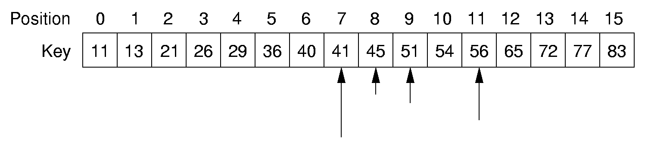
Binary Search
How many elements are examined in worst case?

Slide 53
Binary Search
/** @return The position of an element in sorted array A with value k. If k is not in A,return A.length. */
static int binary(int[] A, int k) {
int l = -1; // Set l and r
int r = A.length; // beyond array bounds
while (l+1 != r) { // Stop when l, r meet
int i = (l+r)/2; // Check middle
if (k < A[i]) r = i; // In left half
if (k == A[i]) return i; // Found it
if (k > A[i]) l = i; // In right half
}
return A.length; // Search value not in A
}

Slide 54
Other Control Statements
while loop: Analyze like a for loop.
if statement: Take greater complexity of then/else clauses.
switch statement: Take complexity of most expensive case.
Subroutine call: Complexity of the subroutine.
Notes:
if statement: The probabilities for the then/else clauses being executed must be independent of n.
switch statement: The probabilities of the various clauses being executed must be independent of n.

Slide 55
Problems
Problem: a task to be performed.
Best thought of as inputs and matching outputs.
Problem definition should include constraints on the resources that may be consumed by any acceptable solution.
Notes:
But NO constraints on HOW the problem is solved

Slide 56
Problems (cont)
Problems ⇔ mathematical functions
A function is a matching between inputs (the domain) and outputs (the range).
An input to a function may be single number, or a collection of information.
The values making up an input are called the parameters of the function.
A particular input must always result in the same output every time the function is computed.

Slide 57
Algorithms and Programs
Algorithm: a method or a process followed to solve a problem.
A recipe.
An algorithm takes the input to a problem (function) and transforms it to the output.
A mapping of input to output.
A problem can have many algorithms.

Slide 58
Analyzing Problems
Upper bound: Upper bound of best known algorithm.
Lower bound: Lower bound for every possible algorithm.
Notes:
Analyzing problems is done a lot in a senior algorithms class.

Slide 59
Analyzing Problems: Example
May or may not be able to obtain matching upper and lower bounds.
Example of imperfect knowledge: Sorting
1. Cost of I/O: Ω(n).
2. Bubble or insertion sort: O(n²).
3. A better sort (Quicksort, Mergesort, Heapsort, etc.): O(n log n).
4. We prove later that sorting is in Ω(n log n).
Notes:
The examples so far have been easy in that exact equations always yield Θ. Thus, it is hard to distinguish Ω and O. This example should help to explain the difference. Bounds are used to describe our level of uncertainty about an algorithm.

Slide 60
Space/Time Tradeoff Principle
One can often reduce time if one is willing to sacrifice space, or vice versa.
Encoding or packing information
Boolean flags
Table lookup
Factorials
Disk-based Space/Time Tradeoff Principle: The smaller you make the disk storage requirements, the faster your program will run.

Slide 61
Multiple Parameters
Compute the rank ordering for all C pixel values in a picture of P pixels.
for (i=0; i<C; i++) // Initialize count
count[i] = 0;
for (i=0; i<P; i++) // Look at all pixels
count[value(i)]++; // Increment count
sort(count); // Sort pixel counts
If we use P as the measure, then time is Θ(P log P).
More accurate is Θ(P + C log C).
Notes:
Example picture size: 256 colors (8 bits), 1000 by 1000 pixels.

Slide 62
Space Complexity
Space complexity can also be analyzed with asymptotic complexity analysis.
Time: Algorithm
Space: Data Structure

Slide 63
Lists
A list is a finite, ordered sequence of data items.
Important concept: List elements have a position.
Notation: <a₀, a₁, …, a_{n-1}>
What operations should we implement?
Notes:
Students should already be familiar with lists.
Chapter objective: Use algorithm analysis in a familiar context to compare implementations.

Slide 64
List Implementation Concepts
Our list implementation will support the concept of a current position.
Operations will act relative to the current position.
<20, 23 | 12, 15>
Notes:
Here, 12 is the “current” node. We use a bar to its left to indicate this in the notation.

Slide 65
List ADT
public interface List<E> {
public void clear();
public void insert(E item);
public void append(E item);
public E remove();
public void moveToStart();
public void moveToEnd();
public void prev();
public void next();
public int length();
public int currPos();
public void moveToPos(int pos);
public E getValue();
}
Notes:
This is an example ADT that our list implementations must match.
A key point to note here: This says nothing about HOW the list is implemented! That comes later, and we will use this ADT for our two different implementations.

Slide 66
List ADT Examples
List: <12 | 32, 15>
L.insert(99);
Result: <12 | 99, 32, 15>
Iterate through the whole list:
for (L.moveToStart(); L.currPos()<L.length();
L.next()) {
it = L.getValue();
doSomething(it);
}

Slide 67
List Find Function
/** @return True if k is in list L,
false otherwise */
public static boolean
find(List<Integer> L, int k) {
for (L.moveToStart(); L.currPos()<L.length(); L.next())
if (k == L.getValue()) return true;
return false; // k not found
}

Slide 68
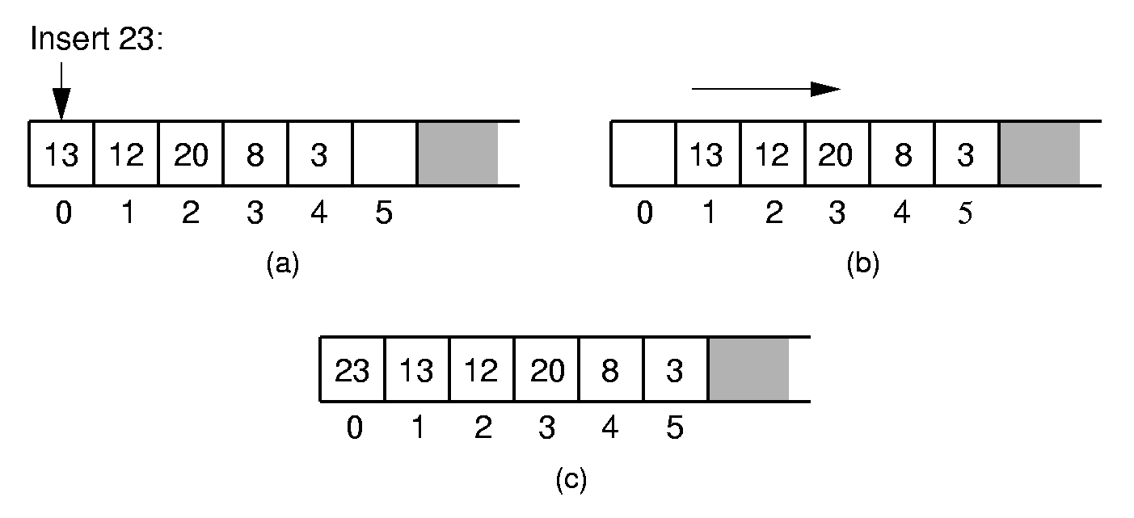
Array-Based List Insert
Notes:
Push items up/down. Cost: Θ(n).

Slide 69
Array-Based List Class (1)
class AList<E> implements List<E> {
private static final int defaultSize = 10;
private int maxSize;
private int listSize;
private int curr;
private E[] listArray;
// Constructors
AList() { this(defaultSize); }
@SuppressWarnings("unchecked")
AList(int size) {
maxSize = size;
listSize = curr = 0;
listArray = (E[])new Object[size];
}

Slide 70
Array-Based List Class (2)
public void clear()
{ listSize = curr = 0; }
public void moveToStart() { curr = 0; }
public void moveToEnd() { curr = listSize; }
public void prev() { if (curr != 0) curr--; }
public void next()
{ if (curr < listSize) curr++; }
public int length() { return listSize; }
public int currPos() { return curr; }

Slide 71
Array-Based List Class (3)
public void moveToPos(int pos) {
assert (pos>=0) && (pos<=listSize) :
"Position out of range";
curr = pos;
}
public E getValue() {
assert (curr >= 0) && (curr < listSize) :
"No current element";
return listArray[curr];
}

Slide 72
Insert
/** Insert "it" at current position */
public void insert(E it) {
assert listSize < maxSize :
"List capacity exceeded";
for (int i=listSize; i>curr; i--)
listArray[i] = listArray[i-1];
listArray[curr] = it;
listSize++;
}

Slide 73
Append
public void append(E it) { // Append "it"
assert listSize < maxSize :
"List capacity exceeded";
listArray[listSize++] = it;
}

Slide 74
Remove
/** Remove and return the current element */
public E remove() {
if ((curr < 0) || (curr >= listSize))
return null;
E it = listArray[curr];
for(int i=curr; i<listSize-1; i++)
listArray[i] = listArray[i+1];
listSize--;
return it;
}

Slide 75
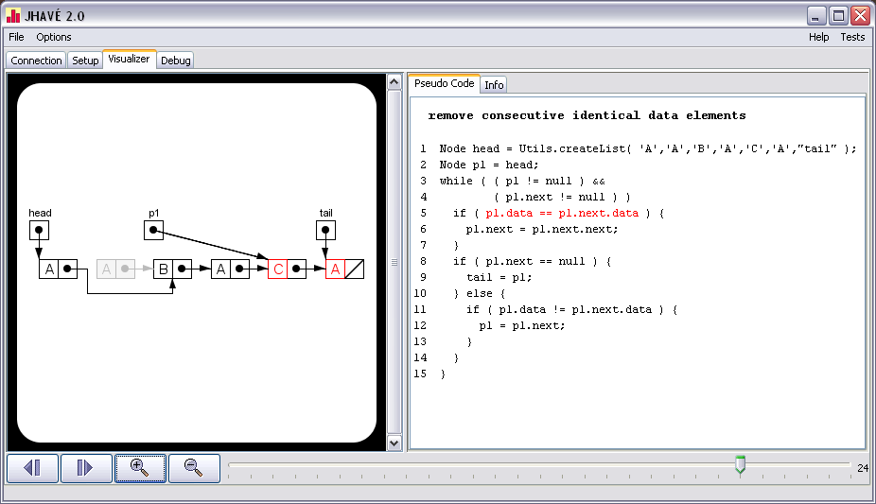
Linked List Manipulation
If you would like practice with linked lists, check out JHAVEPOP:
http://jhave.org/jhavepop/
(AlgoViz Catalog entry http://algoviz.org/catalog/entry/1935)

Slide 76
Link Class
Dynamic allocation of new list elements.
class Link<E> {
private E element;
private Link<E> next;
// Constructors
Link(E it, Link<E> nextval)
{ element = it; next = nextval; }
Link(Link<E> nextval) { next = nextval; }
Link<E> next() { return next; }
Link<E> setNext(Link<E> nextval)
{ return next = nextval; }
E element() { return element; }
E setElement(E it) { return element = it; }
}

Slide 77
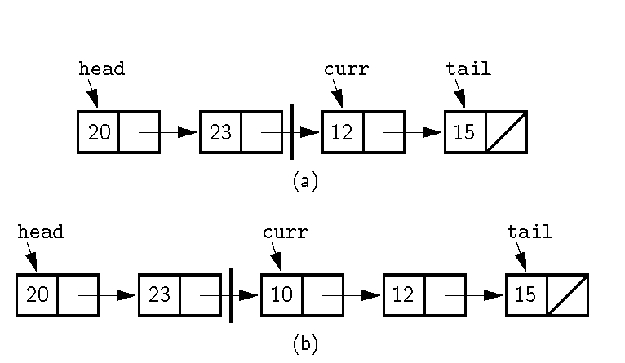
Linked List Position (1)
Notes:
Naïve approach: Curr points to first node in right partition. We want to insert 10 at the beginning of the right partition. No access if available to the node with value 23. How can we do the insert?

Slide 78
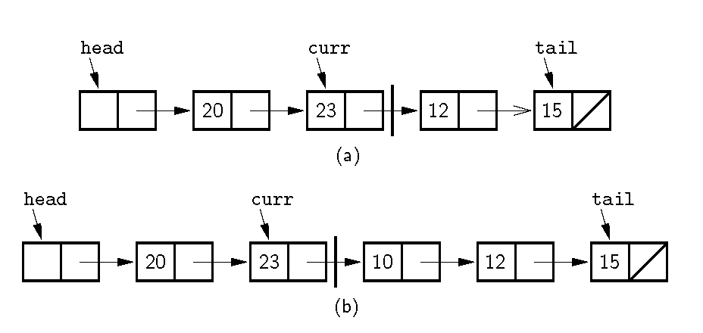
Linked List Position (2)
Notes:
Alternative Implementation: Curr points to the node preceding the actual first node in the right partition. Now we can do the insert. Also note use of the header node. The header node eliminates special cases in the code.

Slide 79
Linked List Class (1)
class LList<E> implements List<E> {
private Link<E> head;
private Link<E> tail;
protected Link<E> curr;
int cnt;
//Constructors
LList(int size) { this(); }
LList() {
curr = tail = head = new Link<E>(null);
cnt = 0;
}

Slide 80
Linked List Class (2)
public void clear() {
head.setNext(null);
curr = tail = head = new Link<E>(null);
cnt = 0;
}
public void moveToStart() { curr = head; }
public void moveToEnd() { curr = tail; }
public int length() { return cnt; }
public void next() {
if (curr != tail) { curr = curr.next(); }
}
public E getValue() {
assert curr.next() != null :
"Nothing to get";
return curr.next().element();
}

Slide 81
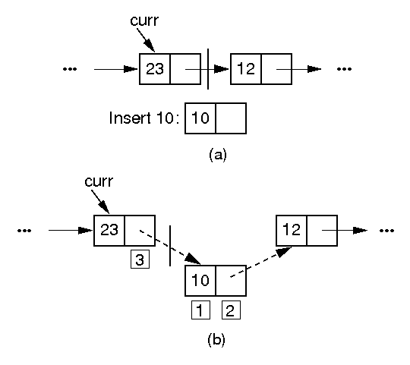
Insertion

Slide 82
Insert/Append
// Insert "it" at current position
public void insert(E it) {
curr.setNext(new Link<E>(it, curr.next()));
if (tail == curr) tail = curr.next();
cnt++;
}
public void append(E it) {
tail = tail.setNext(new Link<E>(it, null));
cnt++;
}

Slide 83
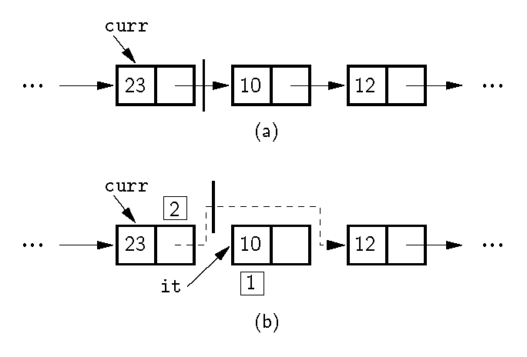
Removal

Slide 84
Remove
/** Remove and return current element */
public E remove() {
if (curr.next() == null) return null;
E it = curr.next().element();
if (tail == curr.next()) tail = curr;
curr.setNext(curr.next().next());
cnt--;
return it;
}

Slide 85
Prev
/** Move curr one step left;
no change if already at front */
public void prev() {
if (curr == head) return;
Link<E> temp = head;
// March down list until we find the
// previous element
while (temp.next() != curr)
temp = temp.next();
curr = temp;
}

Slide 86
Get/Set Position
/** Return position of the current element */
public int currPos() {
Link<E> temp = head;
int i;
for (i=0; curr != temp; i++)
temp = temp.next();
return i;
}
/** Move down list to "pos" position */
public void moveToPos(int pos) {
assert (pos>=0) && (pos<=cnt) :
"Position out of range";
curr = head;
for(int i=0; i<pos; i++)
curr = curr.next();
}

Slide 87
Comparison of Implementations
Array-Based Lists:
Insertion and deletion are Θ(n).
Prev and direct access are Θ(1).
Array must be allocated in advance.
No overhead if all array positions are full.
Linked Lists:
Insertion and deletion are Θ(1).
Prev and direct access are Θ(n).
Space grows with number of elements.
Every element requires overhead.
Notes:
Applies to both average and worst cases.

Slide 88
Space Comparison
“Break-even” point:
DE = n(P + E);
n = DE
P + E
E: Space for data value.
P: Space for pointer.
D: Number of elements in array.

Slide 89
Space Example
Array-based list: Overhead is one pointer (4 bytes) per position in array – whether used or not.
Linked list: Overhead is two pointers per link node
one to the element, one to the next link
Data is the same for both.
When is the space the same?
When the array is half full

Slide 90
Freelists
System new and garbage collection are slow.
Add freelist support to the Link class.

Slide 91
Link Class Extensions
static Link freelist = null;
static <E> Link<E> get(E it, Link<E> nextval) {
if (freelist == null)
return new Link<E>(it, nextval);
Link<E> temp = freelist;
freelist = freelist.next();
temp.setElement(it);
temp.setNext(nextval);
return temp;
}
void release() { // Return to freelist
element = null;
next = freelist;
freelist = this;
}

Slide 92
Using Freelist
public void insert(E it) {
curr.setNext(Link.get(it, curr.next()));
if (tail == curr) tail = curr.next();
cnt++;
}
public E remove() {
if (curr.next() == null) return null;
E it = curr.next().element();
if (tail == curr.next()) tail = curr;
Link<E> tempptr = curr.next();
curr.setNext(curr.next().next());
tempptr.release();
cnt--;
return it;
}

Slide 93
Doubly Linked Lists
class DLink<E> {
private E element;
private DLink<E> next;
private DLink<E> prev;
DLink(E it, DLink<E> p, DLink<E> n)
{ element = it; prev = p; next = n; }
DLink(DLink<E> p, DLink<E> n)
{ prev = p; next = n; }
DLink<E> next() { return next; }
DLink<E> setNext(DLink<E> nextval)
{ return next = nextval; }
DLink<E> prev() { return prev; }
DLink<E> setPrev(DLink<E> prevval)
{ return prev = prevval; }
E element() { return element; }
E setElement(E it) { return element = it; }
}

Slide 94
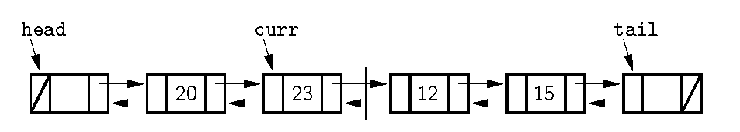
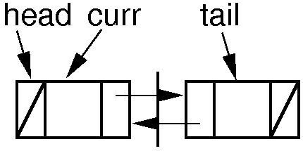
Doubly Linked Lists

Slide 95
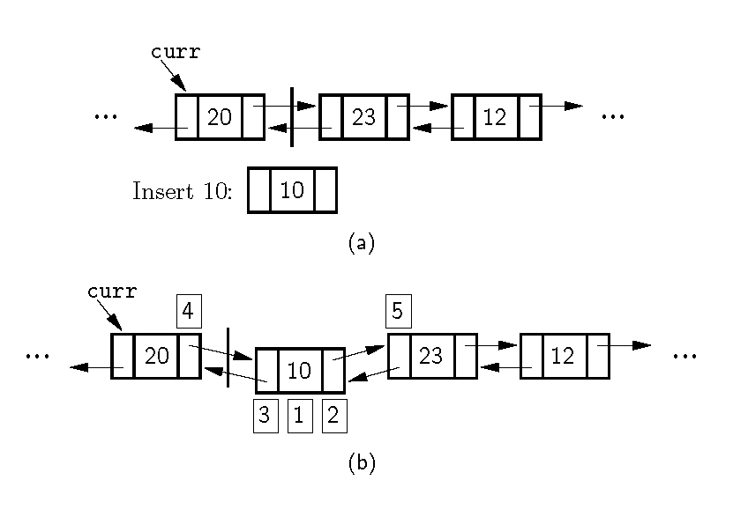
Doubly Linked Insert

Slide 96
Doubly Linked Insert
public void insert(E it) {
curr.setNext(
new DLink<E>(it, curr, curr.next()));
curr.next().next().setPrev(curr.next());
cnt++;
}

Slide 97
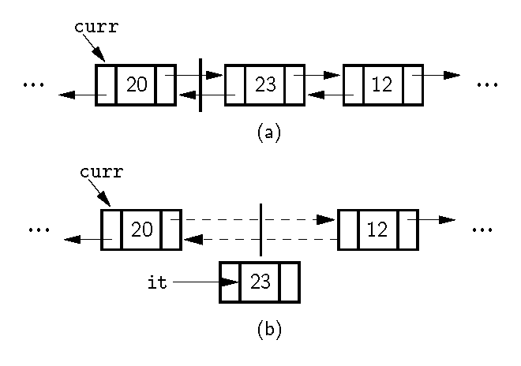
Doubly Linked Remove

Slide 98
Doubly Linked Remove
public E remove() {
if (curr.next() == tail) return null;
E it = curr.next().element();
curr.next().next().setPrev(curr);
curr.setNext(curr.next().next());
cnt--;
return it;
}

Slide 99
Stacks
LIFO: Last In, First Out.
Restricted form of list: Insert and remove only at front of list.
Notation:
Insert: PUSH
Remove: POP
The accessible element is called TOP.

Slide 100
Stack ADT
public interface Stack<E> {
/** Reinitialize the stack. */
public void clear();
/** Push an element onto the top of the stack.
@param it Element being pushed onto the stack.*/
public void push(E it);
/** Remove and return top element.
@return The element at the top of the stack.*/
public E pop();
/** @return A copy of the top element. */
public E topValue();
/** @return Number of elements in the stack. */
public int length();
};

Slide 101
Array-Based Stack
// Array-based stack implementation
private int maxSize; // Max size of stack
private int top; // Index for top
private E [] listArray;
Issues:
Which end is the top?
Where does “top” point to?
What are the costs of the operations?

Slide 102
Linked Stack
class LStack<E> implements Stack<E> {
private Link<E> top;
private int size;
What are the costs of the operations?
How do space requirements compare to the array-based stack implementation?

Slide 103
Queues
FIFO: First in, First Out
Restricted form of list: Insert at one end, remove from the other.
Notation:
Insert: Enqueue
Delete: Dequeue
First element: Front
Last element: Rear

Slide 104
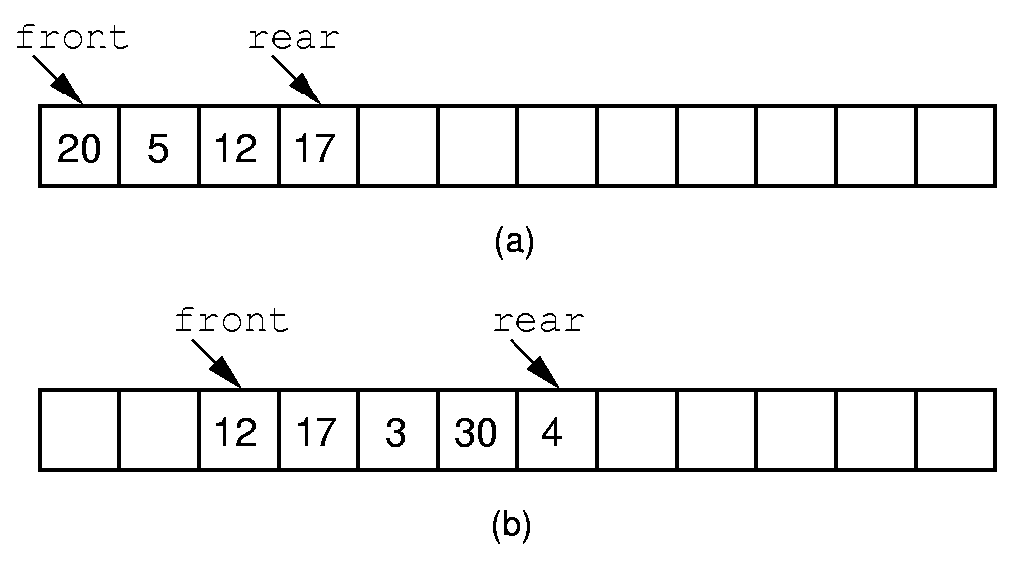
Queue Implementation (1)
Notes:
If we stick to the requirement that the queue elements be at the beginning n elements of the array, then either enqueue or dequeue must be θ(n).
Better is to let the elements “drift” within the array.
Unfortunately, as items are added and removed, the queue “drifts” toward the end. Eventually, there will be no space to the right of the queue, even though there is space in the array.

Slide 105
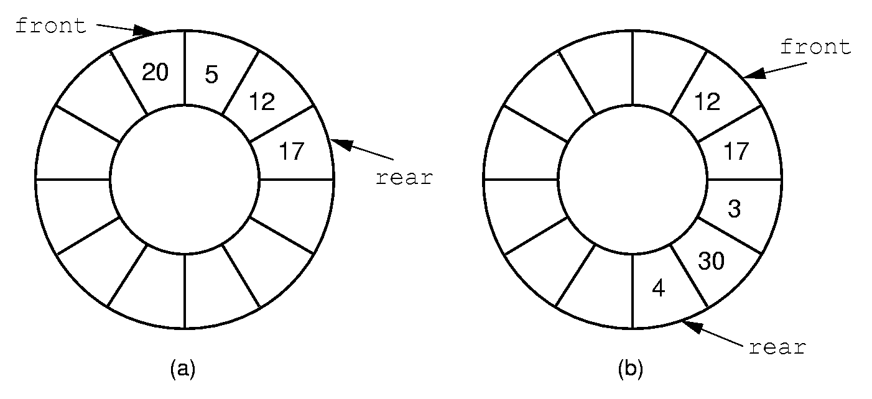
Queue Implementation (2)
Notes:
By using the mod function, we can easily achieve the effect of a “circular” queue.
This leaves one more issue. Where do the front and rear pointers go (point to the item? Or to the space before/after the item)? And, how do we distinguish a full from an empty queue?
Given a fixed position for the front element (and its pointer), there are n-1 possible states for the queue (0 through n elements in the queue for an array of size n), but only n possible positions for rear. To solve this dilemma, we must either leave an empty slot in the queue, or use and external variable to determine if the queue is empty or not.

Slide 106
Dictionary
Often want to insert records, delete records, search for records.
Required concepts:
Search key: Describe what we are looking for
Key comparison
Equality: sequential search
Relative order: sorting
Notes:
Key: When describing what we are looking for, we don’t want to be required to describe the entire record, only one field of the record. If we already knew everything about the record, we probably wouldn’t need to look for it.

Slide 107
Records and Keys
Problem: How do we extract the key from a record?
Records can have multiple keys.
Fundamentally, the key is not a property of the record, but of the context.
Solution: We will explicitly store the key with the record.
Notes:
Can’t just compare records to each other. Need to extract the key. How? Could have an explicit key field? No. Explicit key method? No. Records can have multiple keys.
Could the key method be type sensitive? No, multiple fields in the record can have the same type. There is a fundamental problem: They key is not a property of the record, it is a property of the context in which the record is being used.
Key-Value pair. This is a traditional solution to this problem.
Note that the key is overhead. But this becomes less of a problem as the relative size of the record gets large.

Slide 108
Dictionary ADT
public interface Dictionary<Key, E> {
public void clear();
public void insert(Key k, E e);
public E remove(Key k); // Null if none
public E removeAny(); // Null if none
public E find(Key k); // Null if none
public int size();
};

Slide 109
Payroll Class
// Simple payroll entry: ID, name, address
class Payroll {
private Integer ID;
private String name;
private String address;
Payroll(int inID, String inname, String inaddr) {
ID = inID;
name = inname;
address = inaddr;
}
public Integer getID() { return ID; }
public String getname() { return name; }
public String getaddr() { return address; }
}

Slide 110
Using Dictionary
// IDdict organizes Payroll records by ID
Dictionary<Integer, Payroll> IDdict =
new UALdictionary<Integer, Payroll>();
// namedict organizes Payroll records by name
Dictionary<String, Payroll> namedict =
new UALdictionary<String, Payroll>();
Payroll foo1 = new Payroll(5, "Joe", "Anytown");
Payroll foo2 = new Payroll(10, "John", "Mytown");
IDdict.insert(foo1.getID(), foo1);
IDdict.insert(foo2.getID(), foo2);
namedict.insert(foo1.getname(), foo1);
namedict.insert(foo2.getname(), foo2);
Payroll findfoo1 = IDdict.find(5);
Payroll findfoo2 = namedict.find("John");
Notes:
UALdictionary stands for Unsorted Array-based List (implementation for a) dictionary.

Slide 111
Unsorted List Dictionary
class UALdictionary<Key, E>
implements Dictionary<Key, E> {
private static final int defaultSize = 10;
private AList<KVpair<Key, E>> list;
// Constructors
UALdictionary() { this(defaultSize); }
UALdictionary(int sz)
{ list = new AList<KVpair<Key, E>>(sz); }
public void clear() { list.clear(); }
/** Insert an element: append to list */
public void insert(Key k, E e) {
KVpair<Key,E> temp = new KVpair<Key,E>(k, e);
list.append(temp);
}
Notes:
Example implementation using the dictionary ADT.

Slide 112
Sorted vs. Unsorted List Dictionaries
If list were sorted
Could use binary search to speed search
Would need to insert in order, slowing insert
Which is better?
If lots of searches, sorted list is good
If inserts are as likely as searches, then sorting is no benefit.

Slide 113
Binary Trees
A binary tree is made up of a finite set of nodes that is either empty or consists of a node called the root together with two binary trees, called the left and right subtrees, which are disjoint from each other and from the root.
Notes:
Note that this means every node has two children, either or both of which can be empty. Technically, leaf nodes have two empty children.

Slide 114
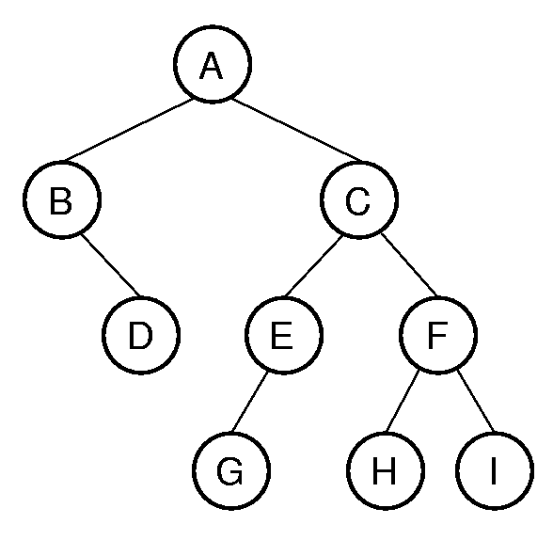
Binary Tree Example
Notation: Node, children, edge, parent, ancestor, descendant, path, depth, height, level, leaf node, internal node, subtree.
Notes:
A has depth 0. B and C form level 1. The tree has height 4. Height = max depth + 1.

Slide 115
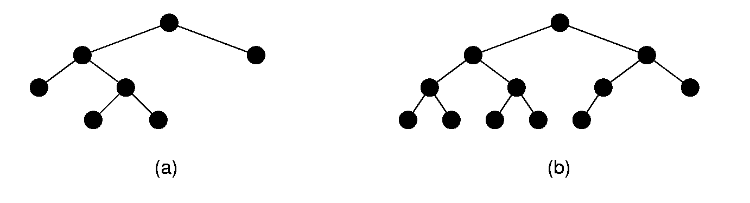
Full and Complete Binary Trees
Full binary tree: Each node is either a leaf or internal node with exactly two non-empty children.
Complete binary tree: If the height of the tree is d, then all leaves except possibly level d are completely full. The bottom level has all nodes to the left side.
Notes:
These terms can be hard to distinguish. Students will need to remember which is which, since this notation will be used several times during the course.

Slide 116
Full Binary Tree Theorem (1)
Theorem: The number of leaves in a non-empty full binary tree is one more than the number of internal nodes.
Proof (by Mathematical Induction):
Base case: A full binary tree with 1 internal node must have two leaf nodes.
Induction Hypothesis: Assume any full binary tree T containing n-1 internal nodes has n leaves.
Notes:
This theorem is important, because it helps us to calculate space requirements. It tells us how many nodes are internal and how many are leaf. We need to know this if we have separate implementations for internal and leaf nodes

Slide 117
Full Binary Tree Theorem (2)
Induction Step: Given tree T with n internal nodes, pick internal node I with two leaf children. Remove I’s children, call resulting tree T’.
By induction hypothesis, T’ is a full binary tree with n leaves.
Restore I’s two children. The number of internal nodes has now gone up by 1 to reach n. The number of leaves has also gone up by 1.
Notes:
Note the style of induction proof: NOT “go forward from n to n+1”. Instead, it reduces an arbitrary tree to one that meets the induction hypothesis, and then restores the original tree while maintaining the proof condition. This is generally easier to do (see explanation in Chapter 2).

Slide 118
Full Binary Tree Corollary
Theorem: The number of null pointers in a non-empty tree is one more than the number of nodes in the tree.
Proof: Replace all null pointers with a pointer to an empty leaf node. This is a full binary tree.

Slide 119
Binary Tree Node Class
/** ADT for binary tree nodes */
public interface BinNode<E> {
/** Return and set the element value */
public E element();
public E setElement(E v);
/** Return the left child */
public BinNode<E> left();
/** Return the right child */
public BinNode<E> right();
/** Return true if this is a leaf node */
public boolean isLeaf();
}

Slide 120
Traversals (1)
Any process for visiting the nodes in some order is called a traversal.
Any traversal that lists every node in the tree exactly once is called an enumeration of the tree’s nodes.

Slide 121
Traversals (2)
Preorder traversal: Visit each node before visiting its children.
Postorder traversal: Visit each node after visiting its children.
Inorder traversal: Visit the left subtree, then the node, then the right subtree.

Slide 122
Traversals (3)
/** @param rt The root of the subtree */
void preorder(BinNode rt)
{
if (rt == null) return; // Empty subtree
visit(rt);
preorder(rt.left());
preorder(rt.right());
}
Notes:
The first implementation is preferred.
The second implementation illustrates a common programming style by many students. It attempts to “look ahead” at the node to be called to determine if it is null or not. This is highly error prone, because the calling function must make sure not to pass in a null pointer for the tree root. It might appear to be more efficient (since it does not make recursive calls on the empty pointers), but it is not in reality since it is checking the pointers twice (to see if not null, then to process them).

Slide 123
Traversals (3)
/** @param rt The root of the subtree */
void preorder(BinNode rt)
{
if (rt == null) return; // Empty subtree
visit(rt);
preorder(rt.left());
preorder(rt.right());
}
// This implementation is error prone
void preorder(BinNode rt) // Not so good
{
visit(rt);
if (rt.left() != null) preorder2(rt.left());
if (rt.right() != null) preorder2(rt.right());
}
Notes:
The first implementation is preferred.
The second implementation illustrates a common programming style by many students. It attempts to “look ahead” at the node to be called to determine if it is null or not. This is highly error prone, because the calling function must make sure not to pass in a null pointer for the tree root. It might appear to be more efficient (since it does not make recursive calls on the empty pointers), but it is not in reality since it is checking the pointers twice (to see if not null, then to process them).

Slide 124
Recursion Examples 1
int count(BinNode rt) {
if (rt == null) return 0;
return 1 + count(rt.left()) +
count(rt.right());
}

Slide 125
Recursion Examples 2
boolean checkBST(BinNode<Integer> rt,
Integer low, Integer high) {
if (rt == null) return true;
Integer rootkey = rt.key();
if ((rootkey < low) || (rootkey > high))
return false; // Out of range
if (!checkBST(rt.left(), low, rootkey))
return false; // Left side failed
return checkBST(rt.right(), rootkey, high);
}

Slide 126
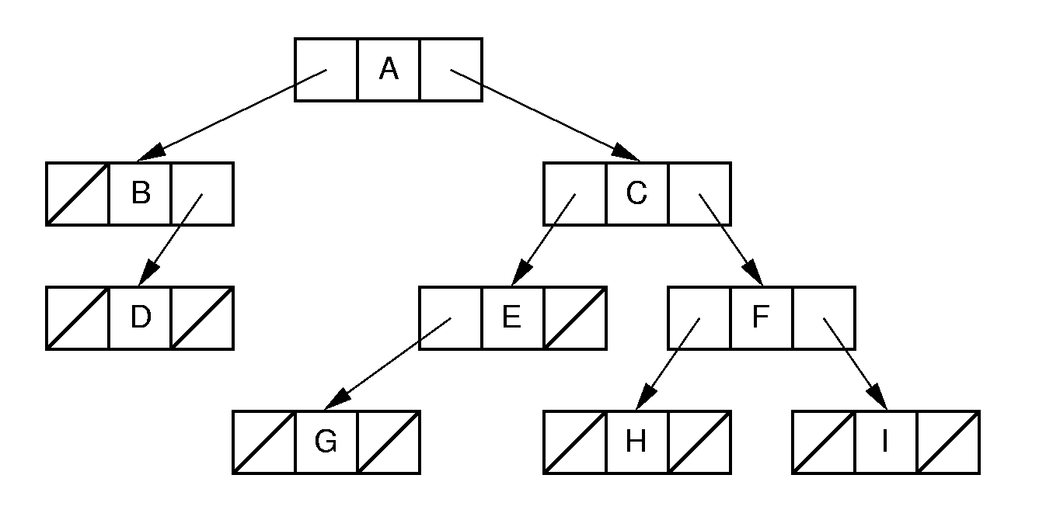
Binary Tree Implementation (1)
Notes:
Standard implementation. Leaf implementation is identical to internal node implementation, resulting in much wasted space due to null pointers. In fact, we know from the full binary tree theorem that half of the pointers are null.

Slide 127
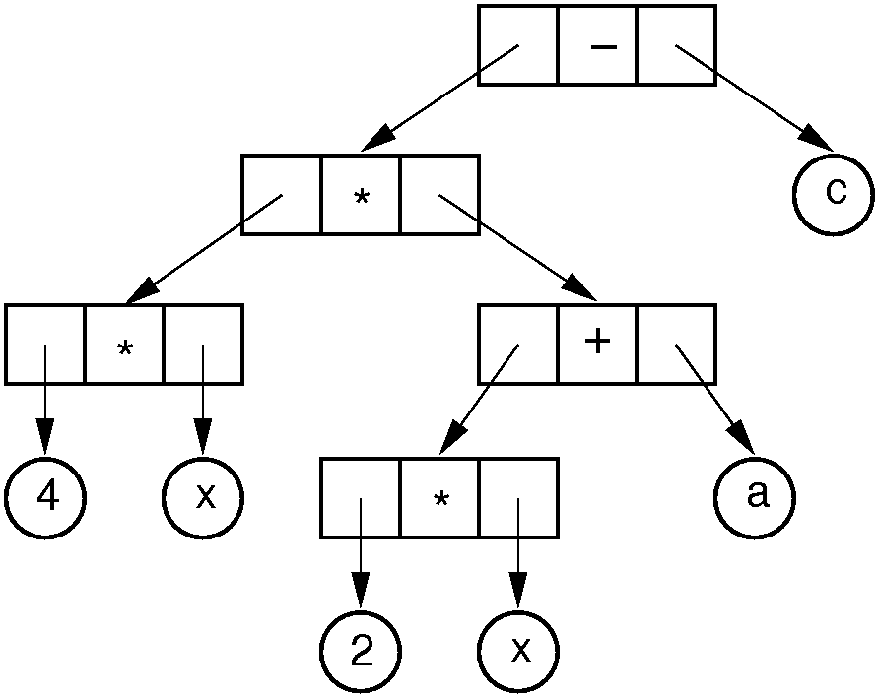
Binary Tree Implementation (2)
Notes:
Example of a tree with distinct internal and leaf node implementations.

Slide 128
Inheritance (1)
/** Base class */
public interface VarBinNode {
public boolean isLeaf();
}
/** Leaf node */
class VarLeafNode implements VarBinNode {
private String operand;
public VarLeafNode(String val)
{ operand = val; }
public boolean isLeaf() { return true; }
public String value() { return operand; }
};

Slide 129
Inheritance (2)
/** Internal node */
class VarIntlNode implements VarBinNode {
private VarBinNode left;
private VarBinNode right;
private Character operator;
public VarIntlNode(Character op,
VarBinNode l, VarBinNode r)
{ operator = op; left = l; right = r; }
public boolean isLeaf() { return false; }
public VarBinNode leftchild() { return left; }
public VarBinNode rightchild(){ return right; }
public Character value() { return operator; }
}

Slide 130
Inheritance (3)
/** Preorder traversal */
public static void traverse(VarBinNode rt) {
if (rt == null) return;
if (rt.isLeaf())
Visit.VisitLeafNode(((VarLeafNode)rt).value());
else {
Visit.VisitInternalNode(
((VarIntlNode)rt).value());
traverse(((VarIntlNode)rt).leftchild());
traverse(((VarIntlNode)rt).rightchild());
}
}

Slide 131
Design Patterns
Design patterns capture reusable pieces of design wisdom.
Goals:
Quickly communicate design wisdom to new designers
Give a shared vocabulary to designers
Notes:
Example: When I say “getters and setters”, most people here know what I mean.

Slide 132
Composite Design Pattern (1)
/* Base class: Composite */
public interface VarBinNode {
public boolean isLeaf();
public void traverse();
}
/* Leaf node: Composite */
class VarLeafNode implements VarBinNode {
private String operand;
public VarLeafNode(String val)
{ operand = val; }
public boolean isLeaf() { return true; }
public String value() { return operand; }
public void traverse()
{ Visit.VisitLeafNode(operand); }
}

Slide 133
Composite (2)
/** Internal node: Composite */
class VarIntlNode implements VarBinNode {
private VarBinNode left;
private VarBinNode right;
private Character operator;
public VarIntlNode(Character op,
VarBinNode l, VarBinNode r)
{ operator = op; left = l; right = r; }
public boolean isLeaf() { return false; }
public VarBinNode leftchild() { return left; }
public VarBinNode rightchild()
{ return right; }
public Character value() { return operator; }
public void traverse() {
Visit.VisitInternalNode(operator);
if (left != null) left.traverse();
if (right != null) right.traverse();
}
}

Slide 134
Composite (3)
/** Preorder traversal */
public static void traverse(VarBinNode rt) {
if (rt != null) rt.traverse();
}

Slide 135
Space Overhead (1)
From the Full Binary Tree Theorem:
Half of the pointers are null.
If leaves store only data, then overhead depends on whether the tree is full.
Ex: Full tree, all nodes the same, with two pointers to children and one to element:
Total space required is (3p + d)n
Overhead: 3pn
If p = d, this means 3p/(3p + d) = 3/4 overhead.

Slide 136
Space Overhead (2)
Eliminate pointers from the leaf nodes:
n/2(2p) p
n/2(2p) + dn p + d
This is 1/2 if p = d.
(2p)/(2p + d) if data only at leaves ⇒ 2/3 overhead.
Note that some method is needed to distinguish leaves from internal nodes.
=
Notes:
This example is for full binary trees.
Half of the nodes have 2 pointers, which is overhead.
The mechanism for distinguishing leaves from internal nodes adds additional overhead not accounted for here.

Slide 137
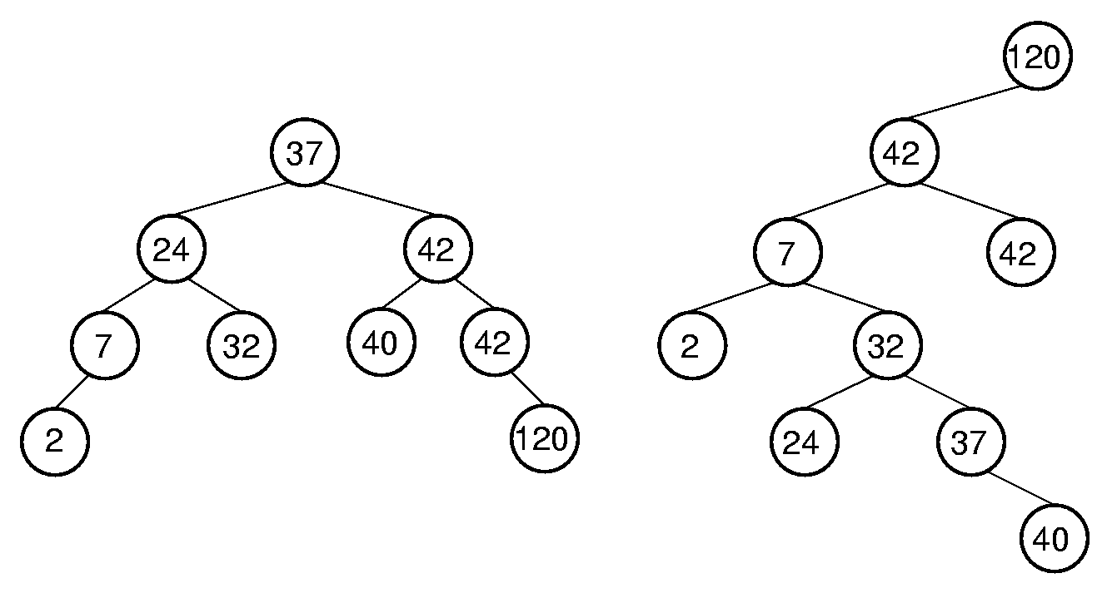
Binary Search Trees
BST Property: All elements stored in the left subtree of a node with value K have values < K. All elements stored in the right subtree of a node with value K have values >= K.
Notes:
Lists have a major problem: Either insert/delete on the one hand, or search on the other, must be Θ(n) time. How can we make both update and search efficient? Answer: Use a new data structure.

Slide 138
BSTNode (1)
class BSTNode<K,E> implements BinNode<E> {
private K key;
private E element;
private BSTNode<K,E> left;
private BSTNode<K,E> right;
public BSTNode() {left = right = null; }
public BSTNode(K k, E val)
{ left = right = null; key = k; element = val; }
public BSTNode(K k, E val,
BSTNode<K,E> l, BSTNode<K,E> r)
{ left = l; right = r; key = k; element = val; }
public K key() { return key; }
public K setKey(K k) { return key = k; }
public E element() { return element; }
public E setElement(E v) { return element = v; }

Slide 139
BSTNode (2)
public BSTNode<K,E> left() { return left; }
public BSTNode<K,E> setLeft(BSTNode<K,E> p)
{ return left = p; }
public BSTNode<K,E> right() { return right; }
public BSTNode<K,E> setRight(BSTNode<K,E> p)
{ return right = p; }
public boolean isLeaf()
{ return (left == null) && (right == null); }
}

Slide 140
BST (1)
/** BST implementation for Dictionary ADT */
class BST<K extends Comparable<? super K>, E>
implements Dictionary<K, E> {
private BSTNode<K,E> root; // Root of BST
private int nodecount; // Size of BST
/** Constructor */
BST() { root = null; nodecount = 0; }
/** Reinitialize tree */
public void clear()
{ root = null; nodecount = 0; }
/** Insert a record into the tree.
@param k Key value of the record.
@param e The record to insert. */
public void insert(K k, E e) {
root = inserthelp(root, k, e);
nodecount++;
}

Slide 141
BST (2)
/** Remove a record from the tree.
@param k Key value of record to remove.
@return Record removed, or null if
there is none. */
public E remove(K k) {
E temp = findhelp(root, k); // find it
if (temp != null) {
root = removehelp(root, k); // remove it
nodecount--;
}
return temp;
}

Slide 142
BST (3)
/** Remove/return root node from dictionary.
@return The record removed, null if empty. */
public E removeAny() {
if (root != null) {
E temp = root.element();
root = removehelp(root, root.key());
nodecount--;
return temp;
}
else return null;
}
/** @return Record with key k, null if none.
@param k The key value to find. */
public E find(K k)
{ return findhelp(root, k); }
/** @return Number of records in dictionary. */
public int size() { return nodecount; }
}

Slide 143
BST Search
private E findhelp(BSTNode<K,E> rt, K k) {
if (rt == null) return null;
if (rt.key().compareTo(k) > 0)
return findhelp(rt.left(), k);
else if (rt.key().compareTo(k) == 0)
return rt.element();
else return findhelp(rt.right(), k);
}

Slide 144
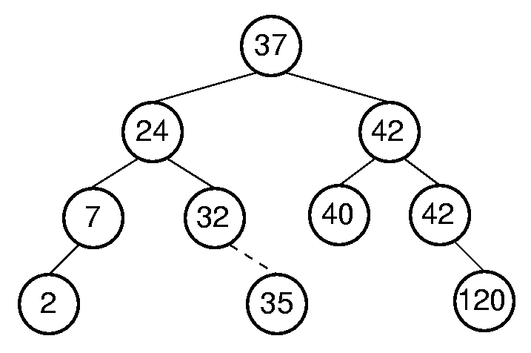
BST Insert (1)

Slide 145
BST Insert (2)
private BSTNode<K,E>
inserthelp(BSTNode<K,E> rt, K k, E e) {
if (rt == null) return new BSTNode<K,E>(k, e);
if (rt.key().compareTo(k) > 0)
rt.setLeft(inserthelp(rt.left(), k, e));
else
rt.setRight(inserthelp(rt.right(), k, e));
return rt;
}

Slide 146
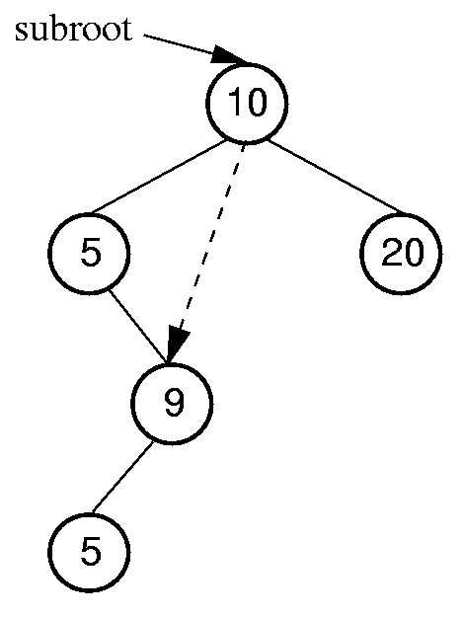
Get/Remove Minimum Value
private BSTNode<K,E>
getmin(BSTNode<K,E> rt) {
if (rt.left() == null)
return rt;
else return getmin(rt.left());
}
private BSTNode<K,E>
deletemin(BSTNode<K,E> rt) {
if (rt.left() == null)
return rt.right();
else {
rt.setLeft(deletemin(rt.left()));
return rt;
}
}

Slide 147
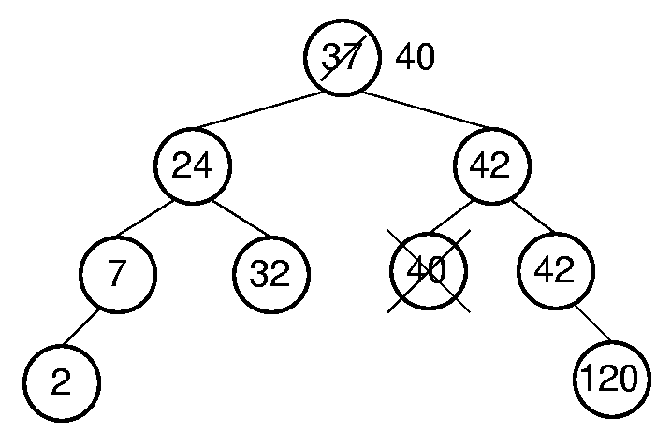
BST Remove (1)

Slide 148
BST Remove (2)
/** Remove a node with key value k
@return The tree with the node removed */
private BSTNode<K,E>
removehelp(BSTNode<K,E> rt, K k) {
if (rt == null) return null;
if (rt.key().compareTo(k) > 0)
rt.setLeft(removehelp(rt.left(), k));
else if (rt.key().compareTo(k) < 0)
rt.setRight(removehelp(rt.right(), k));

Slide 149
BST Remove (3)
else { // Found it, remove it
if (rt.left() == null)
return rt.right();
else if (rt.right() == null)
return rt.left();
else { // Two children
BSTNode<K,E> temp = getmin(rt.right());
rt.setElement(temp.element());
rt.setKey(temp.key());
rt.setRight(deletemin(rt.right()));
}
}
return rt;
}

Slide 150
Time Complexity of BST Operations
Find: O(d)
Insert: O(d)
Delete: O(d)
d = depth of the tree
d is O(log n) if tree is balanced. What is the worst case?
Notes:
All cost depth of the node in question.
Worst case: θ(n).
Average case: θ(log n).

Slide 151
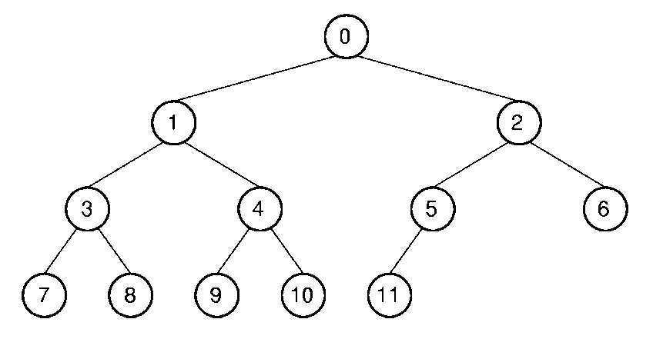
Array Implementation (1)
Position | 0 | 1 | 2 | 3 | 4 | 5 | 6 | 7 | 8 | 9 | 10 | 11
Parent | -- | 0 | 0 | 1 | 1 | 2 | 2 | 3 | 3 | 4 | 4 | 5
Left Child | 1 | 3 | 5 | 7 | 9 | 11 | -- | -- | -- | -- | -- | --
Right Child | 2 | 4 | 6 | 8 | 10 | -- | -- | -- | -- | -- | -- | --
Left Sibling | -- | -- | 1 | -- | 3 | -- | 5 | -- | 7 | -- | 9 | --
Right Sibling | -- | 2 | -- | 4 | -- | 6 | -- | 8 | -- | 10 | -- | --
Notes:
This is a good example of logical representation vs. physical implementation.
Since the complete binary tree is so limited in its shape (there is only one possible shape for n nodes), it is reasonable to expect that space efficiency can be achieved.

Slide 152
Array Implementation (1)
Parent (r) =
Leftchild(r) =
Rightchild(r) =
Leftsibling(r) =
Rightsibling(r) =
Notes:
Parent(r) = (r-1)/2 if r <> 0 and r < n.
Leftchild(r) = 2r + 1 if 2r + 1 < n.
Rightchild(r) = 2r + 2 if 2r + 2 < n.
Leftsibling(r) = r - 1 if r is even, r > 0, and r < n.
Rightsibling(r) = r + 1 if r is odd and r + 1 < n.

Slide 153
Priority Queues (1)
Problem: We want a data structure that stores records as they come (insert), but on request, releases the record with the greatest value (removemax)
Example: Scheduling jobs in a multi-tasking operating system.
Notes:
All cost depth of the node in question.
Worst case: θ(n).
Average case: θ(log n).

Slide 154
Priority Queues (2)
Possible Solutions:
insert appends to an array or a linked list ( O(1) ) and then removemax determines the maximum by scanning the list ( O(n) )
A linked list is used and is in decreasing order; insert places an element in its correct position ( O(n) ) and removemax simply removes the head of the list ( O(1) ).
Use a heap – both insert and removemax are O( log n ) operations

Slide 155
Heaps
Heap: Complete binary tree with the heap property:
Min-heap: All values less than child values.
Max-heap: All values greater than child values.
The values are partially ordered.
Heap representation: Normally the array-based complete binary tree representation.

Slide 156
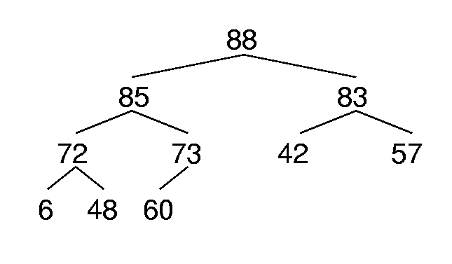
Max Heap Example
88 85 83 72 73 42 57 6 48 60

Slide 157
Max Heap Implementation (1)
public class MaxHeap<K extends Comparable<? super K>, E> {
private E[] Heap; // Pointer to heap array
private int size; // Maximum size of heap
private int n; // # of things in heap
public MaxHeap(E[] h, int num, int max)
{ Heap = h; n = num; size = max; buildheap(); }
public int heapsize() { return n; }
public boolean isLeaf(int pos) // Is pos a leaf position?
{ return (pos >= n/2) && (pos < n); }
public int leftchild(int pos) { // Leftchild position
assert pos < n/2 : "Position has no left child";
return 2*pos + 1;
}
public int rightchild(int pos) { // Rightchild position
assert pos < (n-1)/2 : "Position has no right child";
return 2*pos + 2;
}
public int parent(int pos) {
assert pos > 0 : "Position has no parent";
return (pos-1)/2;
}

Slide 158
Sift Down
public void buildheap() // Heapify contents
{ for (int i=n/2-1; i>=0; i--) siftdown(i); }
private void siftdown(int pos) {
assert (pos >= 0) && (pos < n) :
"Illegal heap position";
while (!isLeaf(pos)) {
int j = leftchild(pos);
if ((j<(n-1)) &&
(Heap[j].compareTo(Heap[j+1]) < 0))
j++; // index of child w/ greater value
if (Heap[pos].compareTo(Heap[j]) >= 0)
return;
DSutil.swap(Heap, pos, j);
pos = j; // Move down
}
}

Slide 159
RemoveMax, Insert
public E removemax() {
assert n > 0 : "Removing from empty heap";
DSutil.swap(Heap, 0, --n);
if (n != 0) siftdown(0);
return Heap[n];
}
public void insert(E val) {
assert n < size : "Heap is full";
int curr = n++;
Heap[curr] = val;
// Siftup until curr parent's key > curr key
while ((curr != 0) &&
(Heap[curr].compareTo(Heap[parent(curr)])
> 0)) {
DSutil.swap(Heap, curr, parent(curr));
curr = parent(curr);
}
}

Slide 160
Example of Root Deletion
Given the initial heap:
97
93
84
90
79
83
81
83
42
55
73
21
83
93
84
90
79
83
81
93
42
55
73
21
83
84
In a heap of N nodes, the maximum distance the root can sift down would be ⎡log (N+1)⎤ - 1.
90
79
83
81
42
55
73
21

Slide 161
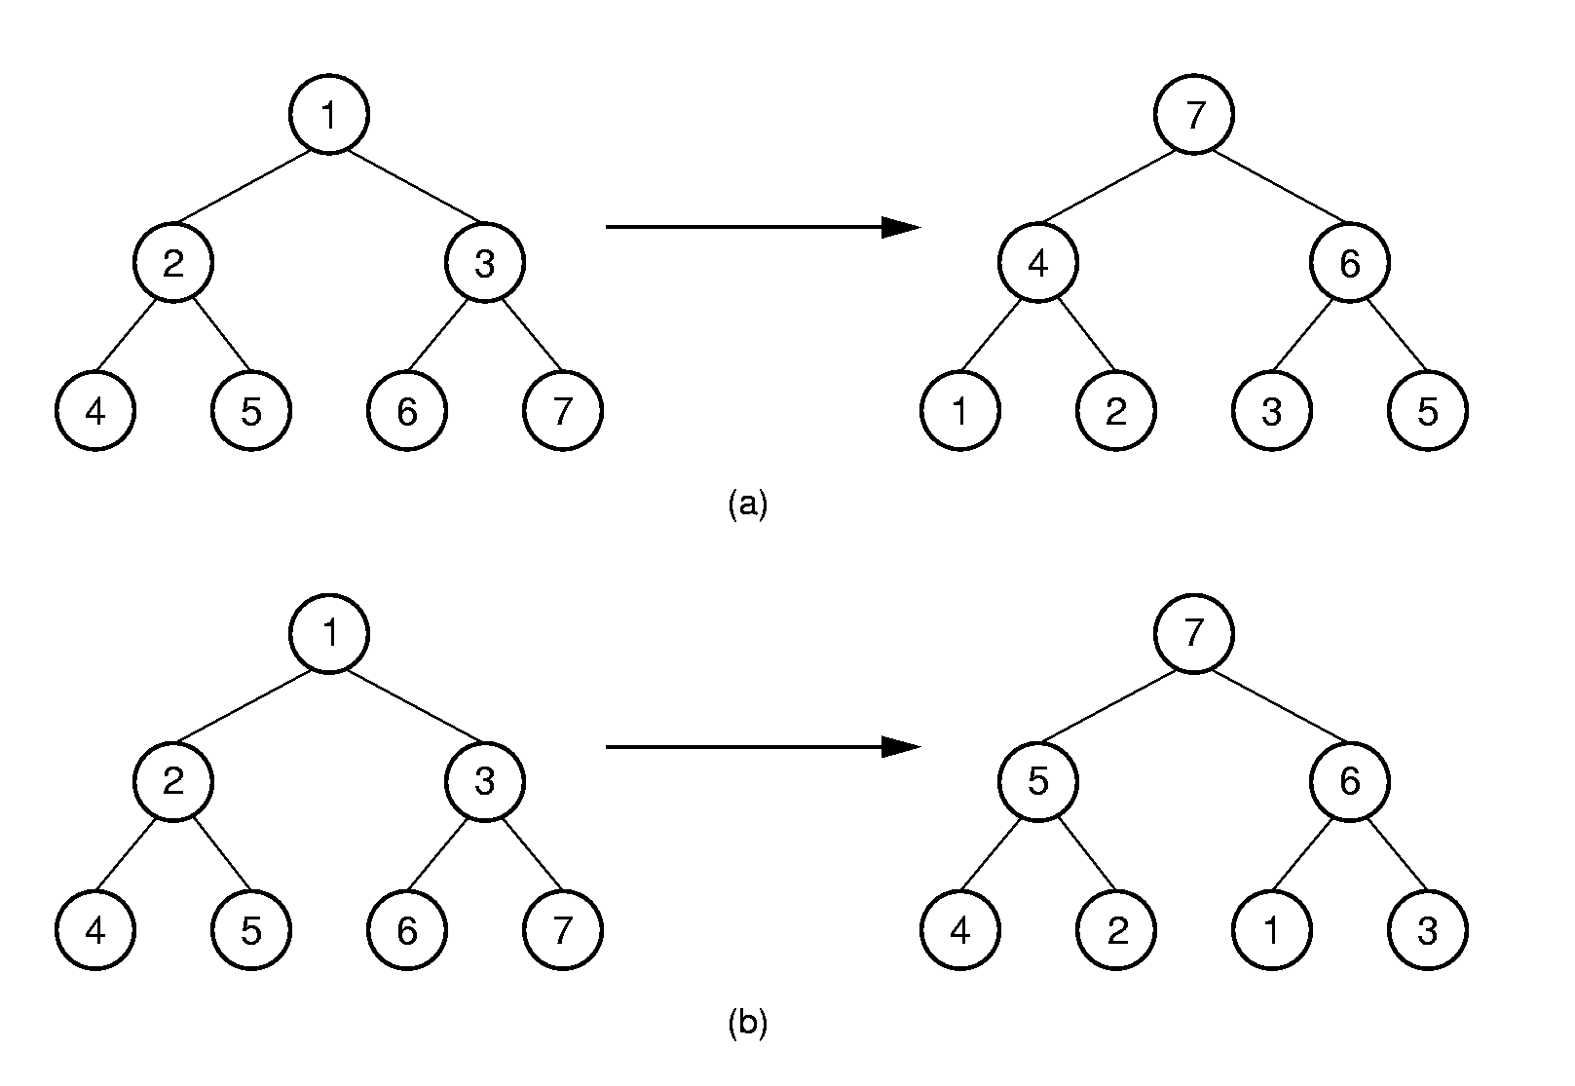
Heap Building
(4-2) (4-1) (2-1) (5-2) (5-4) (6-3) (6-5) (7-5) (7-6)
(5-2) (7-3) (7-1) (6-1)

Slide 162
Heap Building Analysis
Insert into the heap one value at a time:
Push each new value down the tree from the root to where it belongs
Σ log i = Θ(n log n)
Starting with full array, work from bottom up
Since nodes below form a heap, just need to push current node down (at worst, go to bottom)
Most nodes are at the bottom, so not far to go
When i is the level of the node counting from the bottom starting with 1, this is Σ (i-1) n/2^{i} = Θ(n).

Slide 163
Programmer’s View of Files
Logical view of files:
An a array of bytes.
A file pointer marks the current position.
Three fundamental operations:
Read bytes from current position (move file pointer)
Write bytes to current position (move file pointer)
Set file pointer to specified byte position.

Slide 164
Java File Functions
RandomAccessFile(String name, String mode)
close()
read(byte[] b)
write(byte[] b)
seek(long pos)

Slide 165
Primary vs. Secondary Storage
Primary storage: Main memory (RAM)
Secondary Storage: Peripheral devices
Disk drives
Tape drives
Flash drives
Notes:
The “memory hierarchy” is even more complex than this. For example, CPUs have registers and on-board caches, disks drives have hardware caches, etc.

Slide 166
Comparisons
Medium | 1996 | 1997 | 2000 | 20004 | 2006 | 2007 | 2008
RAM | $45.00 | 7.00 | 1.500 | 0.3500 | 0.1500 | 0.0742 | 0.0339
Disk | 0.25 | 0.10 | 0.010 | 0.0010 | 0.0005 | 0.0004 | 0.0001
Flash | ----- | ----- | ----- | 0.1000 | 0.0900 | 0.0098 | 0.0029
Floppy | 0.50 | 0.36 | 0.250 | 0.2500 | ----- | ----- | -----
Tape | 0.03 | 0.01 | 0.001 | 0.0003 | ----- | ----- | -----
RAM is usually volatile.
RAM is about 1/2 million times faster than disk.
Notes:
The observation about the relative speeds of RAM and disk differing by a factor of around a million has held for decades. Both have increased tremendously in speed, but at roughly similar rates. Even greater changes have been made in data density.

Slide 167
Golden Rule of File Processing
Minimize the number of disk accesses!
1. Arrange information so that you get what you want with few disk accesses.
2. Arrange information to minimize future disk accesses.
An organization for data on disk is often called a file structure.
Disk-based space/time tradeoff: Compress information to save processing time by reducing disk accesses.

Slide 168
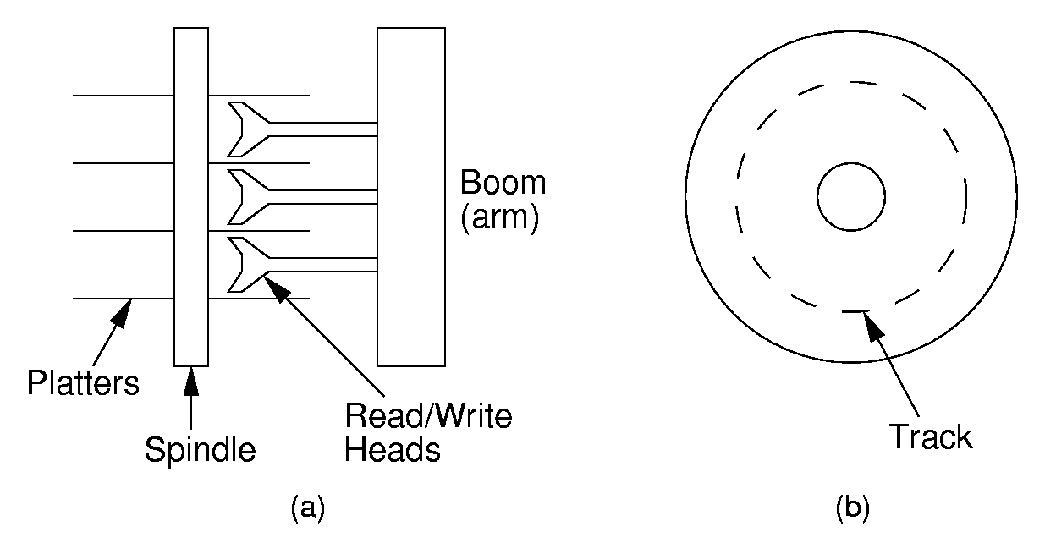
Disk Drives

Slide 169
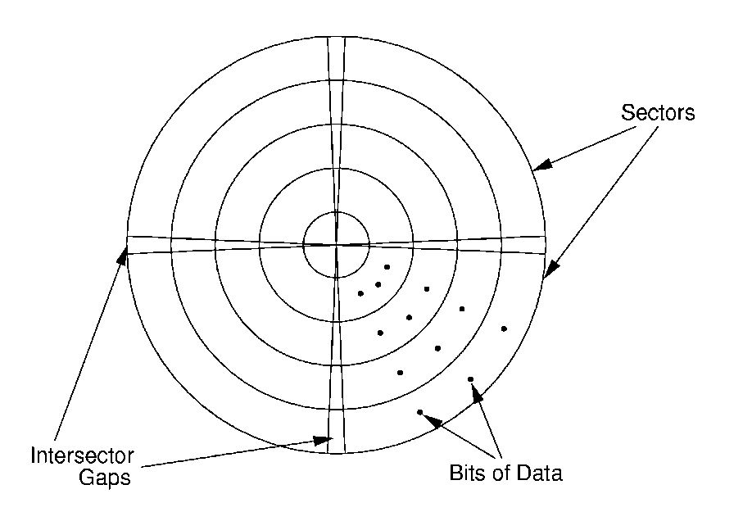
Sectors
A sector is the basic unit of I/O.
Notes:
This diagram does not begin to do justice to the amount of data on a disk! There are thousands of tracks on a platter, and hundreds of sectors on a track. To deal with data density limitations, the tracks are broken into zones, each zone having an appropriate data density.

Slide 170
Terms
Locality of Reference: When record is read from disk, next request is likely to come from near the same place on the disk.
Cluster: Smallest unit of file allocation, usually several sectors.
Extent: A group of physically contiguous clusters.
Internal fragmentation: Wasted space within sector if record size does not match sector size; wasted space within cluster if file size is not a multiple of cluster size.

Slide 171
Seek Time
Seek time: Time for I/O head to reach desired track. Largely determined by distance between I/O head and desired track.
Track-to-track time: Minimum time to move from one track to an adjacent track.
Average Access time: Average time to reach a track for random access.

Slide 172
Other Factors
Rotational Delay or Latency: Time for data to rotate under I/O head.
One half of a rotation on average.
At 7200 rpm, this is 8.3/2 = 4.2ms.
Transfer time: Time for data to move under the I/O head.
At 7200 rpm: Number of sectors read/Number of sectors per track * 8.3ms.

Slide 173
Disk Spec Example
16.8 GB disk on 10 platters = 1.68GB/platter
13,085 tracks/platter
256 sectors/track
512 bytes/sector
Track-to-track seek time: 2.2 ms
Average seek time: 9.5ms
4KB clusters, 32 clusters/track.
5400RPM
Notes:
This disk is obviously obsolete now. But the principles are the same. Even more interesting, while the data density has gone up, and things like RPM have gone up, these changes all tend to balance each other out leaving roughly the same net time to access data off the disk. So over 20 years, what has really changed is greater density achieved without sacrificing access time.

Slide 174
Disk Access Cost Example (1)
Read a 1MB file divided into 2048 records of 512 bytes (1 sector) each.
Assume all records are on 8 contiguous tracks.
First track: 9.5 + (11.1)(1.5) = 26.2 ms
Remaining 7 tracks: 2.2 + (11.1)(1.5) = 18.9ms.
Total: 26.2 + 7 * 18.9 = 158.5ms

Slide 175
Disk Access Cost Example (2)
Read a 1MB file divided into 2048 records of 512 bytes (1 sector) each.
Assume all file clusters are randomly spread across the disk.
256 clusters. Cluster read time is
8/256 of a rotation for about 5.9ms for both latency and read time.
256(9.5 + 5.9) is about 3942ms or nearly 4 sec.
Notes:
This is MUCH worse than the previous example.

Slide 176
How Much to Read?
Read time for one track:
9.5 + (11.1)(1.5) = 26.2ms
Read time for one sector:
9.5 + 11.1/2 + (1/256)11.1 = 15.1ms
Read time for one byte:
9.5 + 11.1/2 = 15.05ms
Nearly all disk drives read/write one sector (or more) at every I/O access
Also referred to as a page or block

Slide 177
More Recent Drive Specs
Samsung Spinpoint T166
500GB (nominal)
7200 RPM
Track to track: 0.8 ms
Average track access: 8.9 ms
Bytes/sector 512
6 surfaces/heads

Slide 178
Buffers
The information in a sector is stored in a buffer or cache.
If the next I/O access is to the same buffer, then no need to go to disk.
There are usually one or more input buffers and one or more output buffers.

Slide 179
Buffer Pools
A series of buffers used by an application to cache disk data is called a buffer pool.
Virtual memory uses a buffer pool to imitate greater RAM memory by actually storing information on disk and “swapping” between disk and RAM.

Slide 180
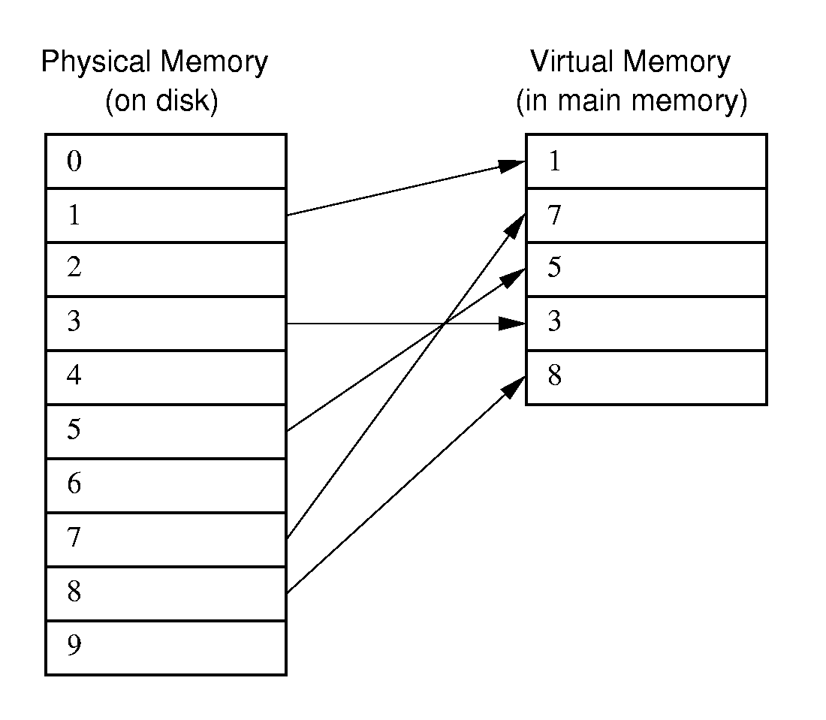
Buffer Pools

Slide 181
Organizing Buffer Pools
Which buffer should be replaced when new data must be read?
First-in, First-out: Use the first one on the queue.
Least Frequently Used (LFU): Count buffer accesses, reuse the least used.
Least Recently used (LRU): Keep buffers on a linked list. When buffer is accessed, bring it to front. Reuse the one at end.
Notes:
LFU in particular needs some care in interpretation. Count total times ever accessed, or times accessed since it came into the pool? This second interpretation would give a newly read block a disadvantage.
When the data in a buffer is replaced, only write to disk if the contents are changed. Another way to look at it: Don’t write to disk when the buffer contents change, only write when the buffer is taken out of the buffer pool.

Slide 182
Bufferpool ADT: Message Passing
/** Buffer pool: message-passing style */
public interface BufferPoolADT {
/** Copy "sz" bytes from "space" to position
"pos" in the buffered storage */
public void insert(byte[] space,
int sz, int pos);
/** Copy "sz" bytes from position "pos" of
the buffered storage to "space". */
public void getbytes(byte[] space,
int sz, int pos);
}

Slide 183
Bufferpool ADT: Buffer Passing
/** Buffer pool: buffer-passing style */
public interface BufferPoolADT {
/** Return pointer to requested block */
public byte[] getblock(int block);
/** Set the dirty bit for the buffer
holding "block" */
public void dirtyblock(int block);
/** Tell the size of a buffer */
public int blocksize();
}

Slide 184
Design Issues
Disadvantage of message passing:
Messages are copied and passed back and forth.
Disadvantages of buffer passing:
The user is given access to system memory (the buffer itself)
The user must explicitly tell the buffer pool when buffer contents have been modified, so that modified data can be rewritten to disk when the buffer is flushed.
The pointer might become stale when the bufferpool replaces the contents of a buffer.

Slide 185
Some Goals
Be able to avoid reading data when the block contents will be replaced.
Be able to support multiple users accessing a buffer, and indpendantly releasing a buffer.
Don’t make an active buffer stale.

Slide 186
Improved Interface
public interface BufferPoolADT {
Buffer acquireBuffer(int block);
}
public interface BufferADT {
// Read the block from disk
public byte[] readBlock();
// Just get pointer to space, no read
public byte[] getDataPointer();
// Contents have changed
public void markDirty();
// Release access to the block
public void release();
}
Notes:
Note the separate BufferPool and Buffer ADTs. Most methods are on a buffer (requested from the buffer pool).

Slide 187
External Sorting
Problem: Sorting data sets too large to fit into main memory.
Assume data are stored on disk drive.
To sort, portions of the data must be brought into main memory, processed, and returned to disk.
An external sort should minimize disk accesses.

Slide 188
Model of External Computation
Secondary memory is divided into equal-sized blocks (512, 1024, etc…)
A basic I/O operation transfers the contents of one disk block to/from main memory.
Under certain circumstances, reading blocks of a file in sequential order is more efficient. (When?)
Primary goal is to minimize I/O operations.
Assume only one disk drive is available.
Notes:
For sequential search to be more efficient than random access to the file
adjacent logical blocks of the file must be physically adjacent.
There must be no competition for the I/O head, either with another process, or within the same process (such as thrashing between and input buffer and an output buffer).

Slide 189
Key Sorting
Often, records are large, keys are small.
Ex: Payroll entries keyed on ID number
Approach 1: Read in entire records, sort them, then write them out again.
Approach 2: Read only the key values, store with each key the location on disk of its associated record.
After keys are sorted the records can be read and rewritten in sorted order.
Notes:
Usually the records are not rewritten in sorted order.
(1) It is expensive (random access to all records).
(2) If there are multiple keys, there is no single “correct” order.

Slide 190
Simple External Mergesort (1)
Quicksort requires random access to the entire set of records.
Better: Modified Mergesort algorithm.
Process n elements in Θ(log n) passes.
A group of sorted records is called a run.
Notes:
Usually the records are not rewritten in sorted order.
(1) It is expensive (random access to all records).
(2) If there are multiple keys, there is no single “correct” order.

Slide 191
Simple External Mergesort (2)
Split the file into two files.
Read in a block from each file.
Take first record from each block, output them in sorted order.
Take next record from each block, output them to a second file in sorted order.
Repeat until finished, alternating between output files. Read new input blocks as needed.
Repeat steps 2-5, except this time input files have runs of two sorted records that are merged together.
Each pass through the files provides larger runs.
Notes:
Usually the records are not rewritten in sorted order.
(1) It is expensive (random access to all records).
(2) If there are multiple keys, there is no single “correct” order.

Slide 192
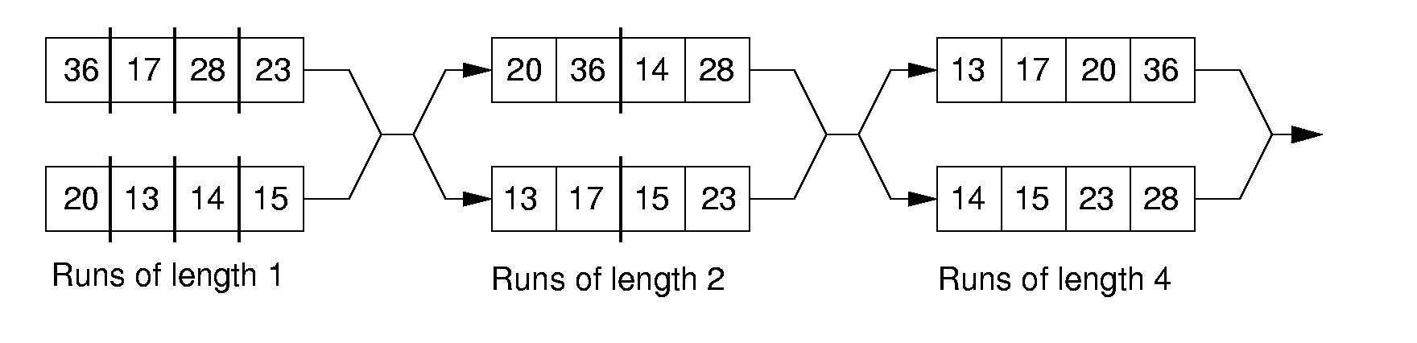
Simple External Mergesort (3)
Notes:
Usually the records are not rewritten in sorted order.
(1) It is expensive (random access to all records).
(2) If there are multiple keys, there is no single “correct” order.

Slide 193
Problems with Simple Mergesort
Is each pass through input and output files sequential?
What happens if all work is done on a single disk drive?
How can we reduce the number of Mergesort passes?
In general, external sorting consists of two phases:
Break the files into initial runs
Merge the runs together into a single run.
Notes:
The passes are sequential. But, on a single disk drive, competition for the I/O head eliminates this advantage.
But, we can get a massive improvement by reading in a block, or several blocks, and using an in-memory sort to create the initial runs.

Slide 194
Breaking a File into Runs
General approach:
Read as much of the file into memory as possible.
Perform an in-memory sort.
Output this group of records as a single run.

Slide 195
Replacement Selection (1)
Break available memory into an array for the heap, an input buffer, and an output buffer.
Fill the array from disk.
Make a min-heap.
Send the smallest value (root) to the output buffer.

Slide 196
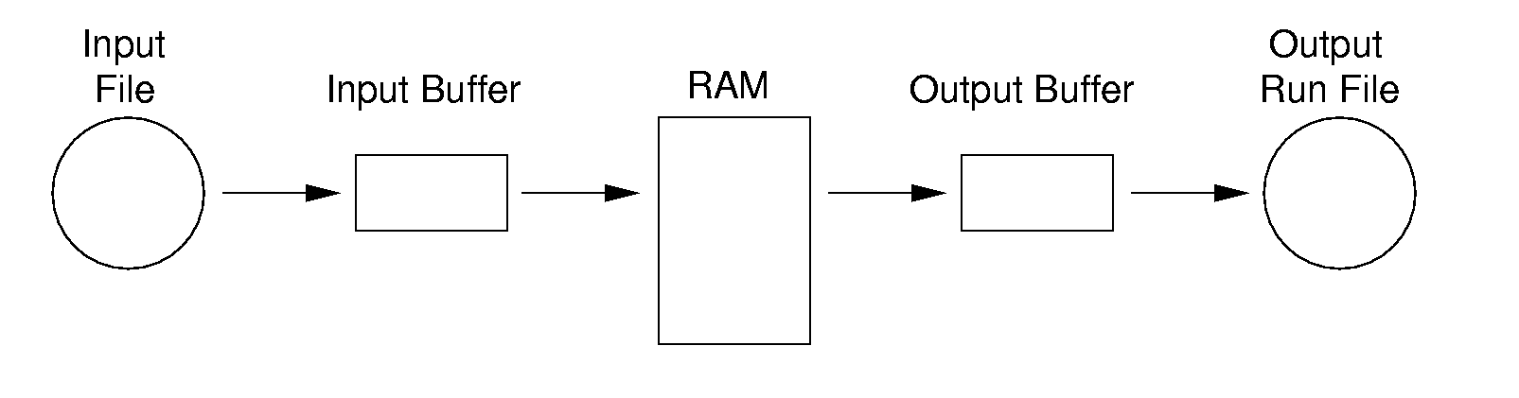
Replacement Selection (2)
If the next key in the file is greater than the last value output, then
Replace the root with this key
else
Replace the root with the last key in the array
Add the next record in the file to a new heap (actually, stick it at the end of the array).

Slide 197
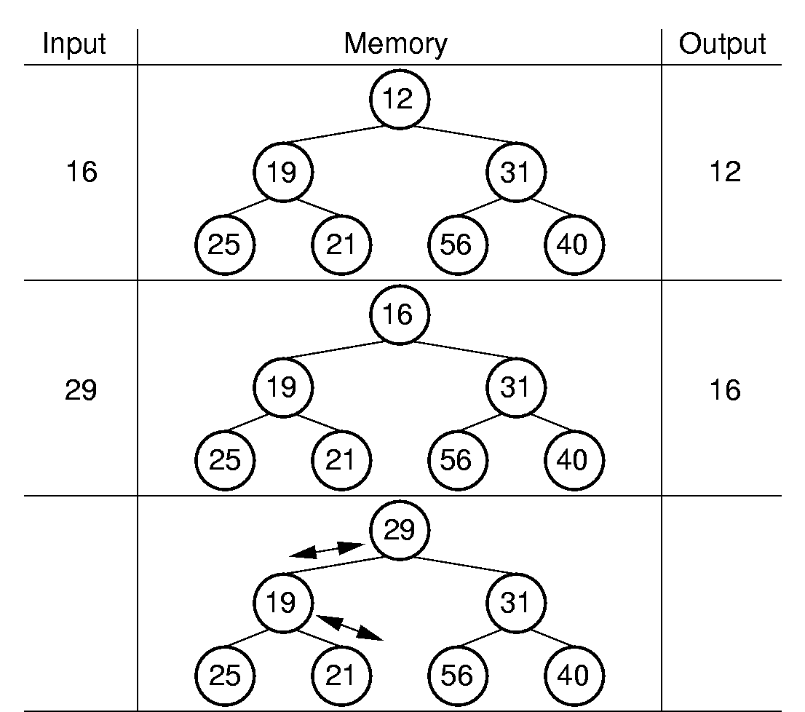
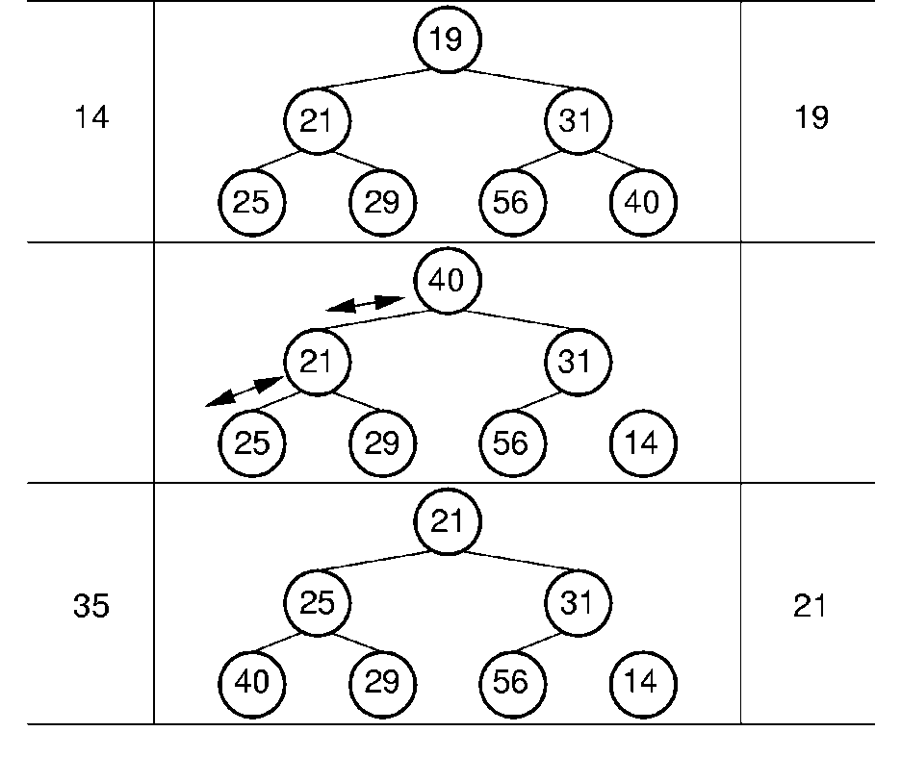
RS Example

Slide 198
Snowplow Analogy (1)
Imagine a snowplow moving around a circular track on which snow falls at a steady rate.
At any instant, there is a certain amount of snow S on the track. Some falling snow comes in front of the plow, some behind.
During the next revolution of the plow, all of this is removed, plus 1/2 of what falls during that revolution.
Thus, the plow removes 2S amount of snow.
Notes:
How many disk drives do we need for the greatest benefit? Two -- one for input, one for output.

Slide 199
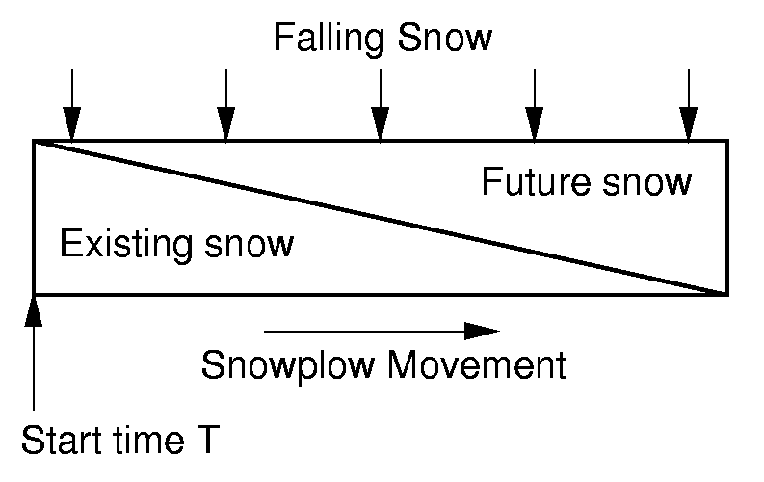
Snowplow Analogy (2)

Slide 200
Problems with Simple Merge
Simple mergesort: Place runs into two files.
Merge the first two runs to output file, then next two runs, etc.
Repeat process until only one run remains.
How many passes for r initial runs?
Is there benefit from sequential reading?
Is working memory well used?
Need a way to reduce the number of passes.
Notes:
For r initial runs, need log r passes.
We get NO benefit from sequential reading if only one disk drive is used.
Working memory is poorly used because only 2 blocks are really needed. So, we would like a way to use memory better.

Slide 201
Multiway Merge (1)
With replacement selection, each initial run is several blocks long.
Assume each run is placed in separate file.
Read the first block from each file into memory and perform an r-way merge.
When a buffer becomes empty, read a block from the appropriate run file.
Each record is read only once from disk during the merge process.

Slide 202
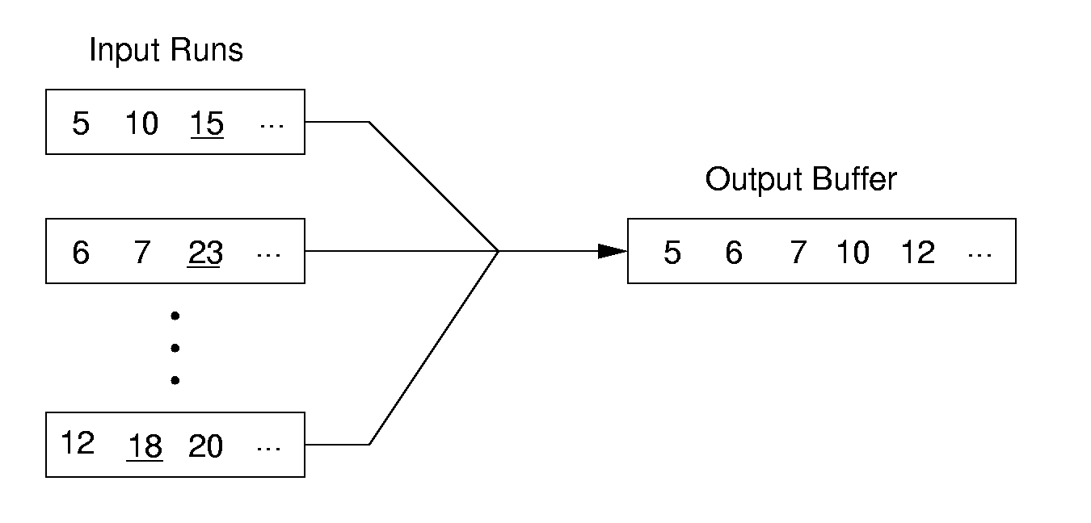
Multiway Merge (2)
In practice, use only one file and seek to appropriate block.

Slide 203
Limits to Multiway Merge (1)
Assume working memory is b blocks in size.
How many runs can be processed at one time?
The runs are 2b blocks long (on average).
How big a file can be merged in one pass?
Notes:
Merge b runs at one time (one block allocated to each run). Replacement selection makes the runs 2b blocks long on average.

Slide 204
Limits to Multiway Merge (2)
Larger files will need more passes -- but the run size grows quickly!
This approach trades (log b) (possibly) sequential passes for a single or very few random (block) access passes.
Notes:
In k merge passes, we process 2b^{(k+1)} blocks.
Example: 0.5MB working memory, 4KB blocks, yield 128 blocks for working memory. Average run size is 1MB, so 128MB can be sorted in one pass on average. 16GB in two merge passes.

Slide 205
General Principles
A good external sorting algorithm will seek to do the following:
Make the initial runs as long as possible.
At all stages, overlap input, processing and output as much as possible.
Use as much working memory as possible. Applying more memory usually speeds processing.
If possible, use additional disk drives for more overlapping of processing with I/O, and allow for more sequential file processing.
Notes:
Overlapping input, processing, and output is sometimes called double buffering. Not all operating systems allow this at the programmer’s level.

Slide 206
Indexing
Goals:
Store large files
Support multiple search keys
Support efficient insert, delete, and range queries

Slide 207
Files and Indexing
Entry sequenced file: Order records by time of insertion.
Search with sequential search
Index file: Organized, stores pointers to actual records.
Could be organized with a tree or other data structure.
Notes:
Entry sequenced files are not practical as an organization for large databases

Slide 208
Keys and Indexing
Primary Key: A unique identifier for records. May be inconvenient for search.
Secondary Key: An alternate search key, often not unique for each record. Often used for search key.

Slide 209
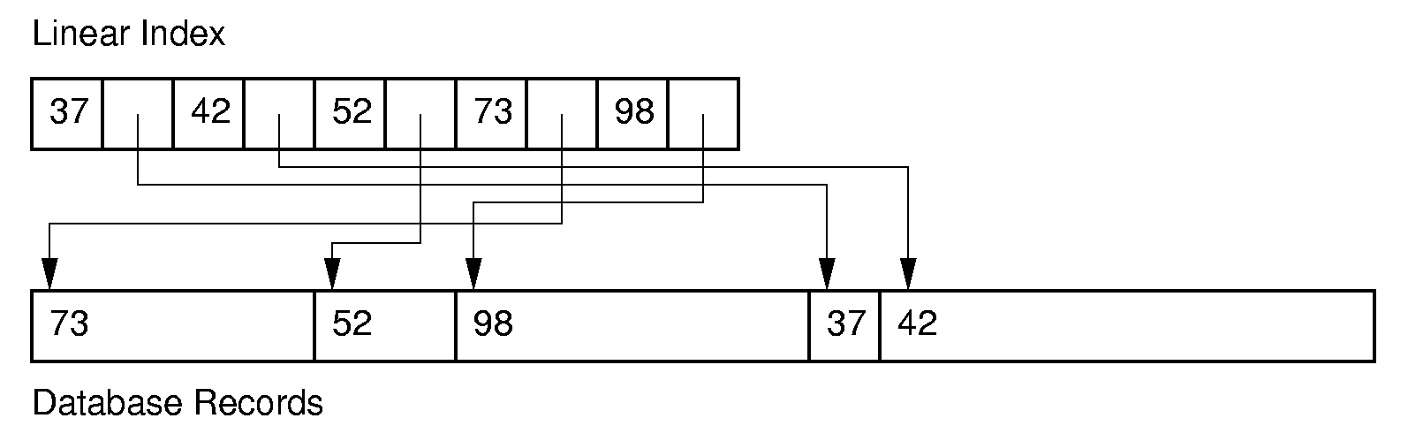
Linear Indexing (1)
Linear index: Index file organized as a simple sequence of key/record pointer pairs with key values are in sorted order.
Linear indexing is good for searching variable-length records.
Notes:
A linear index is good for indexing an entry sequenced file.

Slide 210
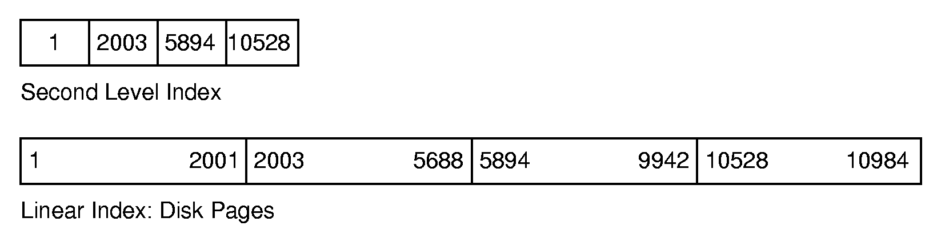
Linear Indexing (2)
If the index is too large to fit in main memory, a second-level index might be used.
Notes:
Second level index stores the first key for each disk page.

Slide 211
Tree Indexing (1)
Linear index is poor for insertion/deletion.
Tree index can efficiently support all desired operations:
Insert/delete
Multiple search keys (multiple indices)
Key range search

Slide 212
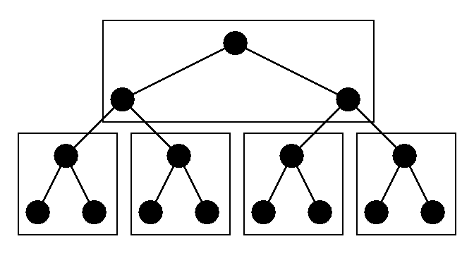
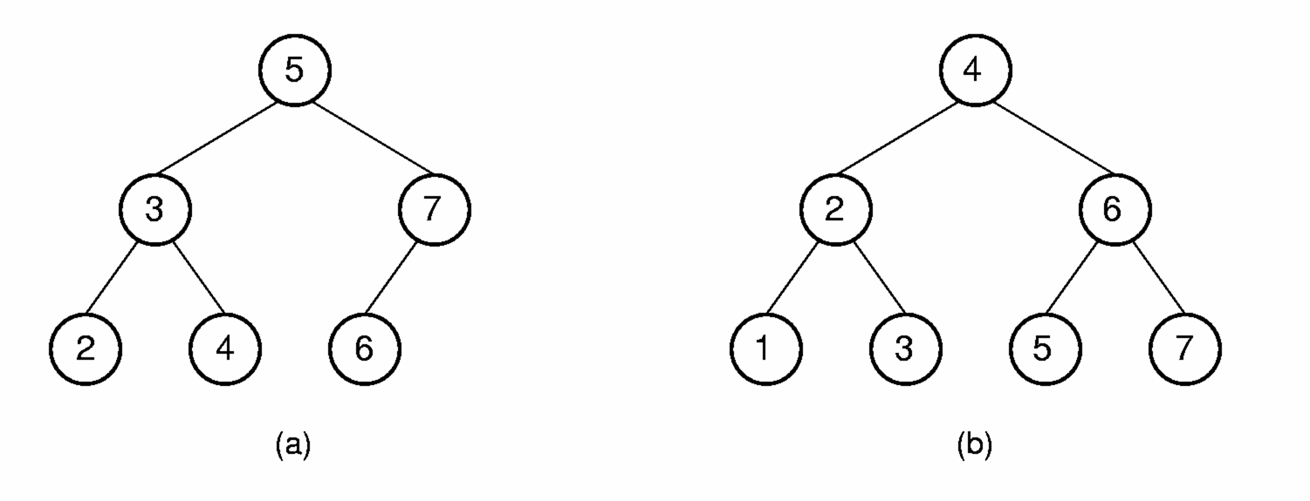
Tree Indexing (2)
Difficulties when storing tree index on disk:
Tree must be balanced.
Each path from root to leaf should cover few disk pages.
Notes:
Second figure illustrates how difficult it can be to keep a tree balanced. In this case, rebalancing the BST to maintain the complete tree shape requires that all nodes be moved. This is too expensive to be practical.

Slide 213
2-3 Tree
A 2-3 Tree has the following properties:
A node contains one or two keys
Every internal node has either two children (if it contains one key) or three children (if it contains two keys).
All leaves are at the same level in the tree, so the tree is always height balanced.
The 2-3 Tree has a search tree property analogous to the BST.

Slide 214
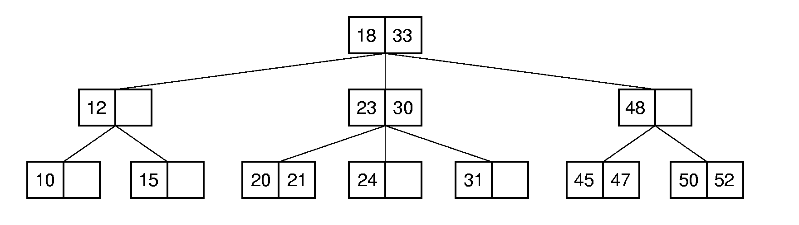
2-3 Tree Example
The advantage of the 2-3 Tree over the BST is that it can be updated at low cost.

Slide 215
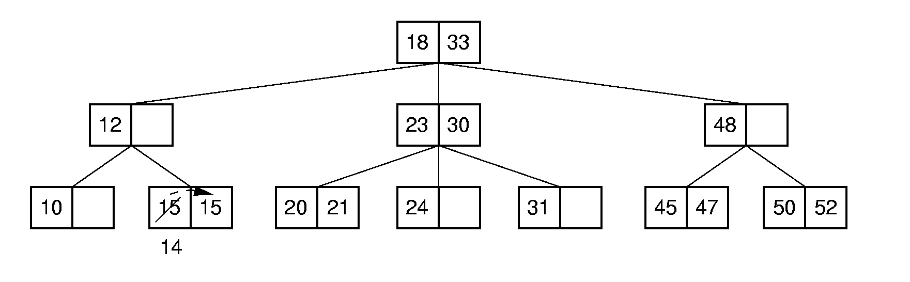
2-3 Tree Insertion (1)

Slide 216
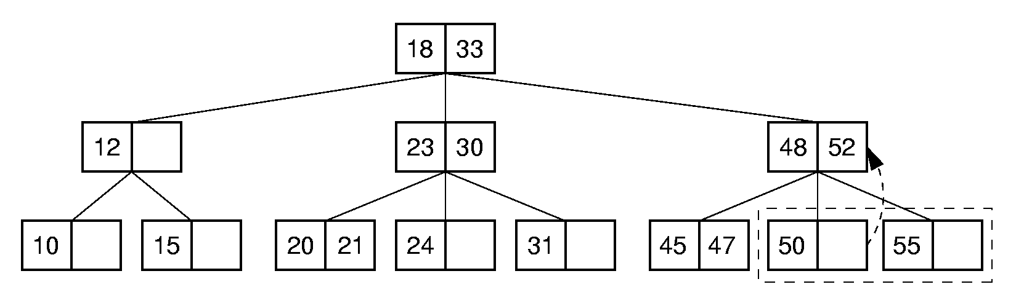
2-3 Tree Insertion (2)

Slide 217
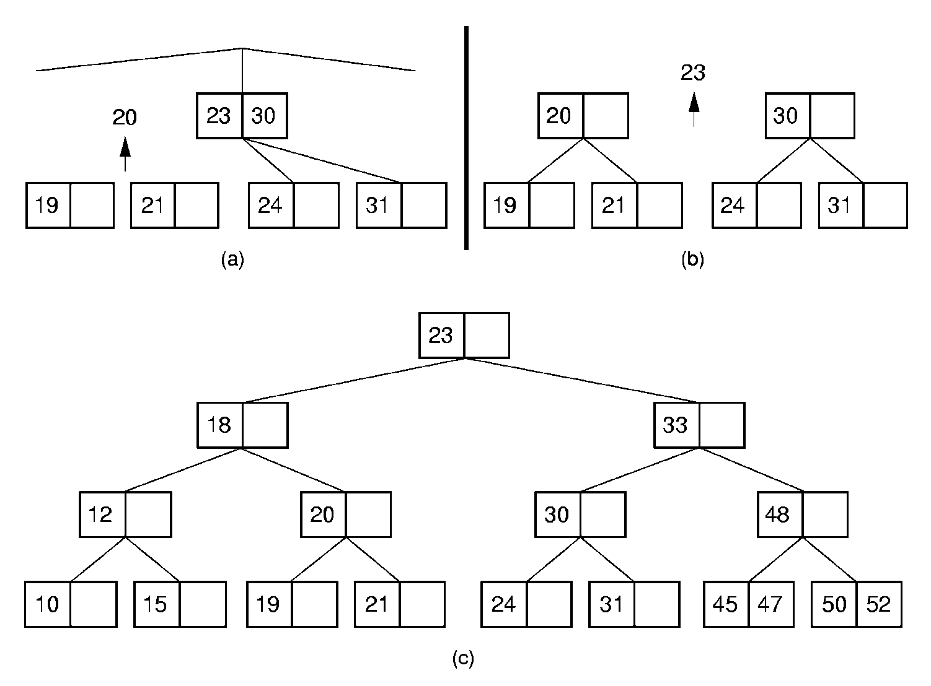
2-3 Tree Insertion (3)

Slide 218
B-Trees (1)
The B-Tree is an extension of the 2-3 Tree.
The B-Tree is now the standard file organization for applications requiring insertion, deletion, and key range searches.

Slide 219
B-Trees (2)
B-Trees are always balanced.
B-Trees keep similar-valued records together on a disk page, which takes advantage of locality of reference.
B-Trees guarantee that every node in the tree will be full at least to a certain minimum percentage. This improves space efficiency while reducing the typical number of disk fetches necessary during a search or update operation.

Slide 220
B-Tree Definition
A B-Tree of order m has these properties:
The root is either a leaf or has two children.
Each node, except for the root and the leaves, has between ⎡m/2⎤ and m children.
All leaves are at the same level in the tree, so the tree is always height balanced.
A B-Tree node is usually selected to match the size of a disk block.
A B-Tree node could have hundreds of children.

Slide 221
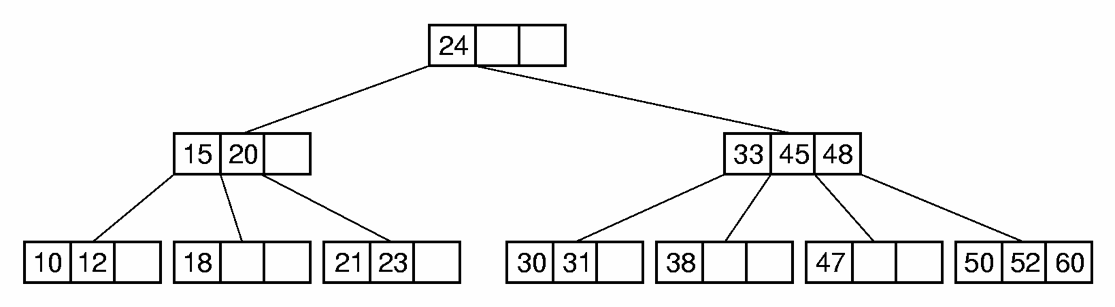
B-Tree Search
Generalizes search in a 2-3 Tree.
Do binary search on keys in current node. If search key is found, then return record. If current node is a leaf node and key is not found, then report an unsuccessful search.
Otherwise, follow the proper branch and repeat the process.

Slide 222
B⁺-Trees
The most commonly implemented form of the B-Tree is the B⁺-Tree.
Internal nodes of the B⁺-Tree do not store record -- only key values to guild the search.
Leaf nodes store records or pointers to records.
A leaf node may store more or less records than an internal node stores keys.

Slide 223
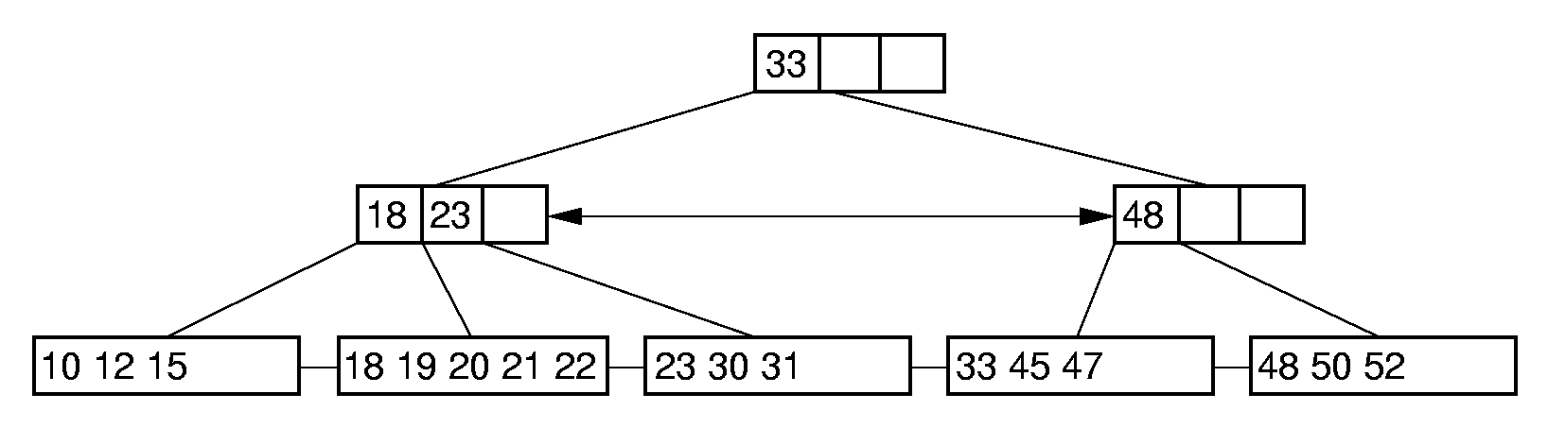
B⁺-Tree Example

Slide 224
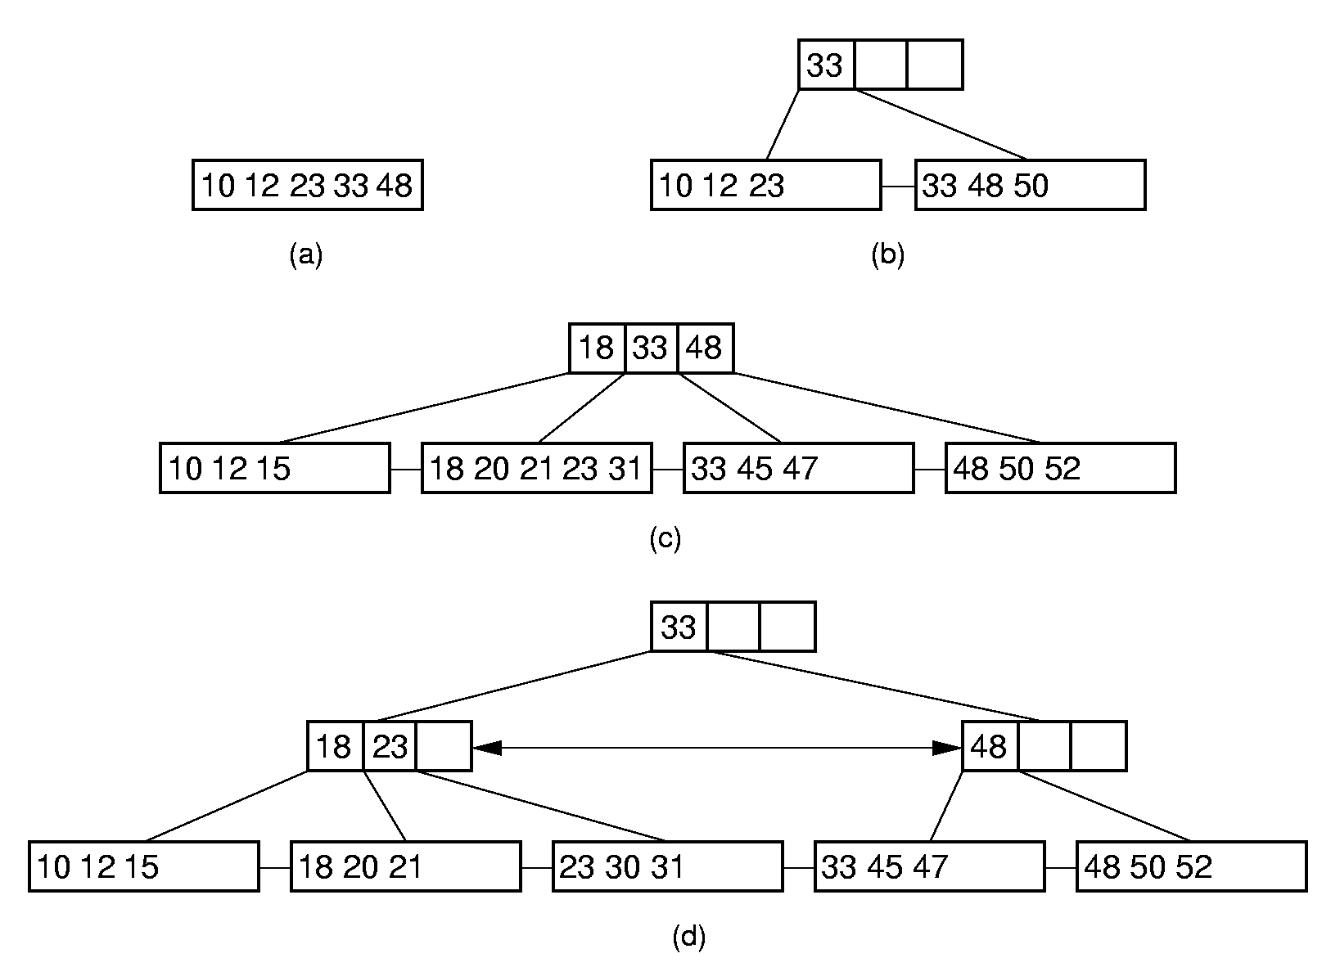
B⁺-Tree Insertion

Slide 225
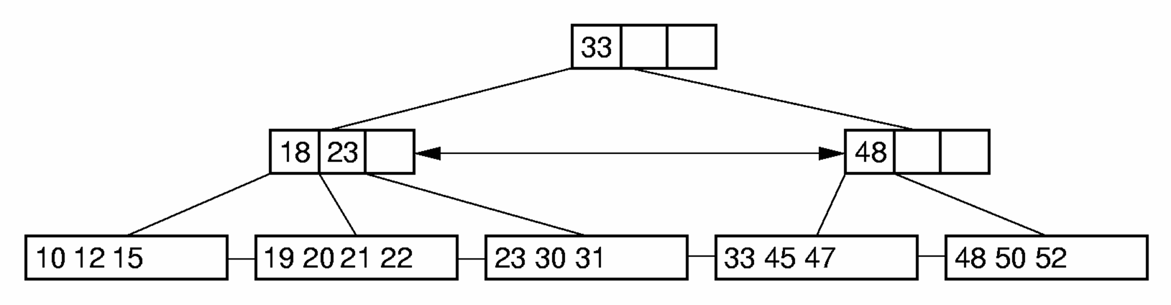
B⁺-Tree Deletion (1)
Notes:
Delete 18

Slide 226

B⁺-Tree Deletion (2)
Notes:
Delete 12. Borrow 18 from the second child.

Slide 227

B⁺-Tree Deletion (3)
Notes:
Delete 12. Borrow 18 from the second child.

Slide 228
B-Tree Space Analysis (1)
B⁺-Trees nodes are always at least half full.
The B*-Tree splits two pages for three, and combines three pages into two. In this way, nodes are always 2/3 full.
Asymptotic cost of search, insertion, and deletion of nodes from B-Trees is Θ(log n).
Base of the log is the (average) branching factor of the tree.

Slide 229
B-Tree Space Analysis (2)
Example: Consider a B+-Tree of order 100 with leaf nodes containing 100 records.
1 level B+-tree:
2 level B+-tree:
3 level B+-tree:
4 level B+-tree:
Ways to reduce the number of disk fetches:
Keep the upper levels in memory.
Manage B+-Tree pages with a buffer pool.
Notes:
1 level: Min 0, Max 100
2 level: Min: 2 leaves of 50 for 100 records. Max: 100 leaves with 100 for 10,000 records.
3 level: Min 2 x 50 nodes of leaves, for 5000 records. Max: 100³ = 1,000,000 records.
4 level: Min: 250,00 records (2 * 50 * 50 * 50). Max: 100⁴ = 100 million records.

Slide 230
Graphs
A graph G = (V, E) consists of a set of vertices V, and a set of edges E, such that each edge in E is a connection between a pair of vertices in V.
The number of vertices is written |V|, and the number edges is written |E|.

Slide 231

Graphs (2)

Slide 232
Paths and Cycles
Path: A sequence of vertices v₁, v₂, …, v_{n} of length n-1 with an edge from v_{i} to v_{i+1} for 1 <= i < n.
A path is simple if all vertices on the path are distinct.
A cycle is a path of length 3 or more that connects v_{i} to itself.
A cycle is simple if the path is simple, except the first and last vertices are the same.

Slide 233

Connected Components
An undirected graph is connected if there is at least one path from any vertex to any other.
The maximum connected subgraphs of an undirected graph are called connected components.

Slide 234

Directed Representation

Slide 235

Undirected Representation

Slide 236
Representation Costs
Adjacency Matrix:
Adjacency List:
Notes:
Adjacency matrix requires Θ(|V|²) space.
Adjacency list requires Θ(|V| + |E|) space.
|E| could be as low as 0, or as high as Θ(|V|²).
Which representation actually requires less space depends on the number of edges.

Slide 237
Graph ADT
interface Graph { // Graph class ADT
public void Init(int n); // Initialize
public int n(); // # of vertices
public int e(); // # of edges
public int first(int v); // First neighbor
public int next(int v, int w); // Neighbor
public void setEdge(int i, int j, int wght);
public void delEdge(int i, int j);
public boolean isEdge(int i, int j);
public int weight(int i, int j);
public void setMark(int v, int val);
public int getMark(int v); // Get v’s Mark
}

Slide 238
Graph Traversals
Some applications require visiting every vertex in the graph exactly once.
The application may require that vertices be visited in some special order based on graph topology.
Examples:
Artificial Intelligence Search
Shortest paths problems

Slide 239
Graph Traversals (2)
To insure visiting all vertices:
void graphTraverse(Graph G) {
int v;
for (v=0; v<G.n(); v++)
G.setMark(v, UNVISITED); // Initialize
for (v=0; v<G.n(); v++)
if (G.getMark(v) == UNVISITED)
doTraverse(G, v);
}
Notes:
doTraverse might be implemented by any of the graph traversals that we are about to discuss.

Slide 240
Depth First Search (1)
// Depth first search
void DFS(Graph G, int v) {
PreVisit(G, v); // Take appropriate action
G.setMark(v, VISITED);
for (int w = G.first(v); w < G.n();
w = G.next(v, w))
if (G.getMark(w) == UNVISITED)
DFS(G, w);
PostVisit(G, v); // Take appropriate action
}

Slide 241

Depth First Search (2)
Cost: Θ(|V| + |E|).
Notes:
Order that nodes are processed: ACBFDE

Slide 242
Breadth First Search (1)
Like DFS, but replace stack with a queue.
Visit vertex’s neighbors before continuing deeper in the tree.

Slide 243
Breadth First Search (2)
void BFS(Graph G, int start) {
Queue<Integer> Q = new AQueue<Integer>(G.n());
Q.enqueue(start);
G.setMark(start, VISITED);
while (Q.length() > 0) { // For each vertex
int v = Q.dequeue();
PreVisit(G, v); // Take appropriate action
for (int w = G.first(v); w < G.n();
w = G.next(v, w))
if (G.getMark(w) == UNVISITED) {
// Put neighbors on Q
G.setMark(w, VISITED);
Q.enqueue(w);
}
PostVisit(G, v); // Take appropriate action
}
}

Slide 244

Breadth First Search (3)
Notes:
Order that nodes are processed: ACEBDF

Slide 245
Topological Sort (1)
Problem: Given a set of jobs, courses, etc., with prerequisite constraints, output the jobs in an order that does not violate any of the prerequisites.

Slide 246
Topological Sort (2)
void topsort(Graph G) {
for (int i=0; i<G.n(); i++)
G.setMark(i, UNVISITED);
for (int i=0; i<G.n(); i++)
if (G.getMark(i) == UNVISITED)
tophelp(G, i);
}
void tophelp(Graph G, int v) {
G.setMark(v, VISITED);
for (int w = G.first(v); w < G.n();
w = G.next(v, w))
if (G.getMark(w) == UNVISITED)
tophelp(G, w);
printout(v);
}

Slide 247

Topological Sort (3)
Notes:
Prints in reverse order.

Slide 248
Queue-Based Topsort
void topsort(Graph G) {
Queue<Integer> Q = new AQueue<Integer>(G.n());
int[] Count = new int[G.n()];
int v, w;
for (v=0; v<G.n(); v++) Count[v] = 0;
for (v=0; v<G.n(); v++)
for (w=G.first(v); w<G.n(); w=G.next(v, w))
Count[w]++;
for (v=0; v<G.n(); v++)
if (Count[v] == 0) Q.enqueue(v);
while (Q.length() > 0) {
v = Q.dequeue().intValue();
printout(v);
for (w=G.first(v); w<G.n(); w=G.next(v, w)) {
Count[w]--;
if (Count[w] == 0)
Q.enqueue(w);
}
}
}

Slide 249
Shortest Paths Problems
Input: A graph with weights or costs associated with each edge.
Output: The list of edges forming the shortest path.
Sample problems:
Find shortest path between two named vertices
Find shortest path from S to all other vertices
Find shortest path between all pairs of vertices
Will actually calculate only distances.

Slide 250
Shortest Paths Definitions
d(A, B) is the shortest distance from vertex A to B.
w(A, B) is the weight of the edge connecting A to B.
If there is no such edge, then w(A, B) = ∞.
Notes:
w(A, D) = 20; d(A, D) = 10 (through ABCD).

Slide 251
Single-Source Shortest Paths
Given start vertex s, find the shortest path from s to all other vertices.
Try 1: Visit vertices in some order, compute shortest paths for all vertices seen so far, then add shortest path to next vertex x.
Problem: Shortest path to a vertex already processed might go through x.
Solution: Process vertices in order of distance from s.
Notes:
This solution is known as Dijkstra’s algorithm

Slide 252

Example Graph

Slide 253
Dijkstra’s Algorithm Example
 | A | B | C | D | E
Initial | 0 | ∞ | ∞ | ∞ | ∞
Process A | 0 | 10 | 3 | 20 | ∞
Process C | 0 | 5 | 3 | 20 | 18
Process B | 0 | 5 | 3 | 10 | 18
Process D | 0 | 5 | 3 | 10 | 18
Process E | 0 | 5 | 3 | 10 | 18
Notes:
Assume that we start at A.

Slide 254
Dijkstra’s Implementation
// Compute shortest path distances from s,
// store them in D
void Dijkstra(Graph G, int s, int[] D) {
for (int i=0; i<G.n(); i++) // Initialize
D[i] = Integer.MAX_VALUE;
D[s] = 0;
for (int i=0; i<G.n(); i++) {
int v = minVertex(G, D);
G.setMark(v, VISITED);
if (D[v] == Integer.MAX_VALUE) return;
for (int w = G.first(v); w < G.n();
w = G.next(v, w))
if (D[w] > (D[v] + G.weight(v, w)))
D[w] = D[v] + G.weight(v, w);
}
}

Slide 255
Implementing minVertex
Issue: How to determine the next-closest vertex? (I.e., implement minVertex)
Approach 1: Scan through the table of current distances.
Cost: Θ(|V|² + |E|) = Θ(|V|²).
Approach 2: Store unprocessed vertices using a min-heap to implement a priority queue ordered by D value. Must update priority queue for each edge.
Cost: Θ((|V| + |E|)log|V|)

Slide 256
Approach 1
int minVertex(Graph G, int[] D) {
int v = 0; // Initialize to unvisited vertex;
for (int i=0; i<G.n(); i++)
if (G.getMark(i) == UNVISITED)
{ v = i; break; }
for (int i=0; i<G.n(); i++)
// Now find smallest value
if ((G.getMark(i) == UNVISITED) &&
(D[i] < D[v]))
v = i;
return v;
}

Slide 257
Approach 2
void Dijkstra(Graph G, int s, int[] D) {
int v, w;
DijkElem[] E = new DijkElem[G.e()];
E[0] = new DijkElem(s, 0);
MinHeap<DijkElem> H =
new MinHeap<DijkElem>(E, 1, G.e());
for (int i=0; i<G.n(); i++)
D[i] = Integer.MAX_VALUE;
D[s] = 0;
for (int i=0; i<G.n(); i++) {
do { v = (H.removemin()).vertex(); }
while (G.getMark(v) == VISITED);
G.setMark(v, VISITED);
if (D[v] == Integer.MAX_VALUE) return;
for (w=G.first(v); w<G.n(); w=G.next(v, w))
if (D[w] > (D[v] + G.weight(v, w))) {
D[w] = D[v] + G.weight(v, w);
H.insert(new DijkElem(w, D[w]));
}
}
}

Slide 258
Minimal Cost Spanning Trees
Minimal Cost Spanning Tree (MST) Problem:
Input: An undirected, connected graph G.
Output: The subgraph of G that
1) has minimum total cost as measured by summing the values of all the edges in the subset, and
2) keeps the vertices connected.

Slide 259

MST Example

Slide 260
Prim’s MST Algorithm
// Compute a minimal-cost spanning tree
void Prim(Graph G, int s, int[] D, int[] V) {
int v, w;
for (int i=0; i<G.n(); i++) // Initialize
D[i] = Integer.MAX_VALUE;
D[s] = 0;
for (int i=0; i<G.n(); i++) {
v = minVertex(G, D);
G.setMark(v, VISITED);
if (v != s) AddEdgetoMST(V[v], v);
if (D[v] == Integer.MAX_VALUE) return;
for (w=G.first(v); w<G.n(); w=G.next(v, w))
if (D[w] > G.weight(v, w)) {
D[w] = G.weight(v, w);
V[w] = v;
}
}
}
Notes:
This is an example of a greedy algorithm. Note that its only difference from Dijkstra’s algorithm is in the distance computation. Dijkstra’s algorithm distance is shortest distance from source to vertex in question. Prim’s algorithm distance is shortest distance from any vertex now in the MST to the vertex in question.

Slide 261
Alternate Implementation
As with Dijkstra’s algorithm, the key issue is determining which vertex is next closest.
As with Dijkstra’s algorithm, the alternative is to use a priority queue.
Running times for the two implementations are identical to the corresponding Dijkstra’s algorithm implementations.

Slide 262
Kruskal’s MST Algorithm (1)
Initially, each vertex is in its own MST.
Merge two MST’s that have the shortest edge between them.
Use a priority queue to order the unprocessed edges. Grab next one at each step.
How to tell if an edge connects two vertices already in the same MST?
Use the UNION/FIND algorithm with parent-pointer representation.

Slide 263

Kruskal’s MST Algorithm (2)

Slide 264
Kruskal’s MST Algorithm (3)
Cost is dominated by the time to remove edges from the heap.
Can stop processing edges once all vertices are in the same MST
Total cost: Θ(|V| + |E| log |E|).

Slide 265
Huffman Coding Trees
ASCII codes: 8 bits per character.
Fixed-length coding.
Can take advantage of relative frequency of letters to save space.
Variable-length coding
Build the tree with minimum external path weight.
Z | K | M | C | U | D | L | E
2 | 7 | 24 | 32 | 37 | 42 | 42 | 120

Slide 266

Huffman Tree Construction (1)

Slide 267
Huffman Tree Construction (2)

Slide 268

Assigning Codes
Letter | Freq | Code | Bits
C | 32
D | 42
E | 120
M | 24
K | 7
L | 42
U | 37
Z | 2
Notes:
C: 1110
D: 101
E: 0
F: 1111
K: 111101
L: 110
U: 100
Z: 111100

Slide 269
Coding and Decoding
A set of codes is said to meet the prefix property if no code in the set is the prefix of another.
Code for DEED:
Decode 1011001110111101:
Expected cost per letter:
Notes:
Code for DEED: 101 0 0 101
Decode: DUCK
Expected cost: (1 * 120 + 3 * 121 + 4 * 32 + 5 * 24 + 6 * 9)/ 306 = 785/306 = 2.57

Slide 270
Search Tree vs. Trie
In a BST, the root value splits the key range into everything less than or greater than the key
The split points are determined by the data values
View Huffman tree as a search tree
All keys starting with 0 are in the left branch, all keys starting with 1 are in the right branch
The root splits the key range in half
The split points are determined by the data structure, not the data values
Such a structure is called a Trie

Slide 271

General Trees

Slide 272
General Tree Node
interface GTNode<E> {
public E value();
public boolean isLeaf();
public GTNode<E> parent();
public GTNode<E> leftmostChild();
public GTNode<E> rightSibling();
public void setValue(E value);
public void setParent(GTNode<E> par);
public void insertFirst(GTNode<E> n);
public void insertNext(GTNode<E> n);
public void removeFirst();
public void removeNext();
}

Slide 273

General Tree Traversal
/** Preorder traversal for general trees */
static <E> void preorder(GTNode<E> rt) {
PrintNode(rt);
if (!rt.isLeaf()) {
GTNode<E> temp = rt.leftmostChild();
while (temp != null) {
preorder(temp);
temp = temp.rightSibling();
}
}
}
Notes:
Traversal: RACDEBF

Slide 274

Parent Pointer Implementation

Slide 275
Equivalence Class Problem
The parent pointer representation is good for answering:
Are two elements in the same tree?
/** Determine if nodes in different trees */
public boolean differ(int a, int b) {
Integer root1 = FIND(array[a]);
Integer root2 = FIND(array[b]);
return root1 != root2;
}
Notes:
Examples of equivalence classes:
Connected components in graphs
Point clustering

Slide 276
Union/Find
/** Merge two subtrees */
public void UNION(int a, int b) {
Integer root1 = FIND(a); // Find a’s root
Integer root2 = FIND(b); // Find b’s root
if (root1 != root2) array[root2] = root1;
}
public Integer FIND(Integer curr) {
if (array[curr] == null) return curr;
while (array[curr] != null)
curr = array[curr];
return curr;
}
Want to keep the depth small.
Weighted union rule: Join the tree with fewer nodes to the tree with more nodes.

Slide 277

Equiv Class Processing (1)
Notes:
Initially, all objects are in separate sets (equivalence classes).
(b) shows the result of processing equivalences (A, B), (C, H), (F, G), (D, E), and (I, F).
(c) shows the result of processing equivalences (A, H) and (E, G). Note that weighted union is used.

Slide 278
Equiv Class Processing (2)
Notes:
(d) shows the result of processing equivalence (H, E).

Slide 279

Path Compression
public Integer FIND(Integer curr) {
if (array[curr] == null) return curr;
array[curr] = FIND(array[curr]);
return array[curr];
}
Notes:
Path compression is used to process equivalence (H, E).

Slide 280

Lists of Children
Notes:
The next several slides show various possible implementations for general trees.
A key gauge for the quality of these representations is how well they perform the key tasks of left-child, right-sibling, and parent. This representation is poor for finding the right sibling of a node.

Slide 281

Leftmost Child/Right Sibling (1)
Notes:
Note: Two trees share the same array.

Slide 282

Leftmost Child/Right Sibling (2)
Notes:
Here, the two trees are joined together. Few links need to be adjusted in the implementation to support this join action.

Slide 283

Linked Implementations (1)
Notes:
Essentially an array-based list of children.

Slide 284

Linked Implementations (2)
Notes:
Essentially a linked list of children.

Slide 285

Efficient Linked Implementation

Slide 286
Sequential Implementations (1)
List node values in the order they would be visited by a preorder traversal.
Saves space, but allows only sequential access.
Need to retain tree structure for reconstruction.
Example: For binary trees, us a symbol to mark null links.
AB/D//CEG///FH//I//
For full binary trees, use a bit to indicate internal nodes.
A’B’/DC’E’G/F’HI
Notes:
These examples refer to the tree of Figure 6.17. The second one has two / because the tree is not full.

Slide 287
Sequential Implementations (2)
Example: For general trees, mark the end of each subtree.
RAC)D)E))BF)))

Slide 288
Search
Given: Distinct keys k₁, k₂, …, k_{n} and collection L of n records of the form
(k₁, I₁), (k₂, I₂), …, (k_{n}, I_{n})
where I_{j} is the information associated with key k_{j} for 1 <= j <= n.
Search Problem: For key value K, locate the record (k_{j}, I_{j}) in L such that k_{j} = K.
Searching is a systematic method for locating the record(s) with key value k_{j} = K.

Slide 289
Successful vs. Unsuccessful
A successful search is one in which a record with key k_{j} = K is found.
An unsuccessful search is one in which no record with k_{j} = K is found (and presumably no such record exists).

Slide 290
Approaches to Search
1. Sequential and list methods (lists, tables, arrays).
2. Direct access by key value (hashing)
3. Tree indexing methods.

Slide 291
Average Cost for Sequential Search
How many comparisons does sequential search do on average?
We must know the probability of occurrence for each possible input.
Must K be in L?
For analysis, ignore everything except the position of K in L. Why?
What are the n + 1 events?

Slide 292
Average Cost (cont)
Let k_{i} = I+1 be the number of comparisons when X = L[i].
Let k_{n} = n be the number of comparisons when X is not in L.
Let p_{i} be the probability that X = L[i].
Let p_{n} be the probability that X is not in L[i] for any I.

Slide 293
Generalizing Average Cost
What happens to the equation if we assume all p_{i}'s are equal (except p₀)?
Depending on the value of p₀,
(n+1)/2 < T(n) < n.

Slide 294
Searching Ordered Arrays
Change the model: Assume that the elements are in ascending order.
Is linear search still optimal? Why not?
Optimization: Use linear search, but test if the element is greater than K. Why?
Observation: If we look at L[5] and find that K is bigger, then we rule out L[1] to L[4] as well.
More is Better: If K > L[n], then we know in one test that K is not in L.
What is wrong here?

Slide 295
Jump Search
What is the right amount to jump?
Algorithm:
Check every k'th element (L[k], L[2k], ...).
If K is greater, then go on.
If K is less, then use linear search on the k elements.
This is called Jump Search.

Slide 296
Analysis of Jump Search
If mk <= n < (m+1)k, then the total cost is at most m + k – 1 3-way comparisons.
What should k be?

Slide 297
Jump Search Analysis (cont)
Take the derivative and solve for T'(x) = 0 to find the minimum. This is a minimum when
What is the worst case cost? Roughly

Slide 298
Lessons
We want to balance the work done while selecting a sublist with the work done while searching a sublist.
In general, make sub-problems of equal effort.
This is an example of divide and conquer.
What if we extend this to three levels?
Notes:
While many useful algorithms can result from a “two level” approach, it rarely makes sense to do things at three levels. Instead, we nearly always go to something recursive. The logical extension of jump search to more and more levels is the standard recursive binary search.

Slide 299
Interpolation Search
(Also known as Dictionary Search)
Search L at a position that is appropriate to the value K.
Repeat as necessary to recalculate p for future searches.

Slide 300
Quadratic Binary Search
(This is easier to analyze.)
Compute p and examine
If then sequentially probe
Until we reach a value less than or equal to K.
Similar for

Slide 301
Quadratic Binary Search (cont)
We are now within positions of K.
ASSUME (for now) that this takes a constant number of comparisons.
We now have a sublist of size .
Repeat the process recursively.
What is the cost?

Slide 302
QBS Probe Count
QBS cost is Θ(log log n) if the number of probes on jump search is constant.
From Cebysev’s inequality, we can show that on uniformly distributed data, the average number of probes required will be about 2.4.
Is this better than binary search? Theoretically, yes (in the average case).

Slide 303
Comparison
n | log n | log log n | Diff
16 | 4 | 2 | 2
256 | 8 | 3 | 2.7
64k | 16 | 4 | 4
2³² | 32 | 5 | 6.4
n | log n-1 | 2.4 log log n | Diff
16 | 3 | 4.8 | worse
256 | 7 | 7.2 | same
64k | 15 | 9.6 | 1.6
2³² | 31 | 12 | 2.6

Slide 304
Lists Ordered by Frequency
Order lists by (expected) frequency of occurrence.
Perform sequential search
Cost to access first record: 1
Cost to access second record: 2
Expected search cost:

Slide 305
Examples(1)
(1) All records have equal frequency.
Notes:
p_{i} is the probability of ith record being accessed.

Slide 306
Examples(2)
(2) Geometric Frequency
Notes:
2nd line of definition is to make the probabilities sum to 1.

Slide 307
Zipf Distributions
Applications:
Distribution for frequency of word usage in natural languages.
Distribution for populations of cities, etc.
80/20 rule:
80% of accesses are to 20% of the records.
For distributions following 80/20 rule,
Notes:
H_{n} = Σ(1/i) = log_{e}n.
So this is telling us that for “typical real-life distributions” a list ordered by frequency, when doing sequential search, visits around 10-15% of the list. If we had an application that used standard sequential search, and we wanted to speed it up a bit without a major rewrite of the system to use, say, a search tree, can we take advantage of this observation? Only if we can EASILY approximate a list ordered by frequency. Which leads us to the next topic: Self-organizing lists.

Slide 308
Self-Organizing Lists
Self-organizing lists modify the order of records within the list based on the actual pattern of record accesses.
Self-organizing lists use a heuristic for deciding how to reorder the list. These heuristics are similar to the rules for managing buffer pools.
Notes:
Buffer pools are an example of a self-organizing list.

Slide 309
Heuristics
Order by actual historical frequency of access. (Similar to LFU buffer pool replacement strategy.)
When a record is found, swap it with the first record on list.
Move-to-Front: When a record is found, move it to the front of the list.
Transpose: When a record is found, swap it with the record ahead of it.
Notes:
Move to front and transpose are both good. But, here are a few observations:
Move-to-front is not worse than twice “best arrangement”.
Transpose bad example: Keep swapping the last two elements.

Slide 310
Text Compression Example
Application: Text Compression.
Keep a table of words already seen, organized via Move-to-Front heuristic.
If a word not yet seen, send the word.
Otherwise, send (current) index in the table.
The car on the left hit the car I left.
The car on 3 left hit 3 5 I 5.
This is similar in spirit to Ziv-Lempel coding.

Slide 311

Searching in Sets
For dense sets (small range, high percentage of elements in set).
Can use logical bit operators.
Example: To find all primes that are odd numbers, compute:
0011010100010100 & 0101010101010101
Document processing: Signature files

